Slide 1
Development of the Electricity Industry in the Northwest

Slide 2
Overview
This presentation was prepared at the Pacific Northwest National Laboratory, for the Pacific Northwest Center of Excellence for Clean Energy at Centralia Community College. This work was funded through a US Department of Energy workforce education grant.
This presentation is general to the Northwest, but specific to Washington State and interactions within the Seattle region. The focus on Washington, and the Seattle region in particular, is due primarily to the abundance of historical material for this region.
UW Digital Archives, online: http://content.lib.washington.edu/
HistoryLink.org, online: http://www.historylink.org/
Paul Dorpat and Genevieve McCoy “Building Washington, A History of Washington State Public Utilities”
Neil McReynolds, “A Century of Service, The Puget Power Story”
Myra Phelps, “Public Works in Seattle, A Narrative History The Engineering Department 1875-1975”
Gene Tollefson, “BPA & The Struggle for Power at Cost”
This presentation is not meant to be a comprehensive study of all the issues in the Northwest, but to introduces many of the issues that have shaped the formation of the regions electricity infrastructure.

Slide 3
Module Outline
Part 1: The Early Years of Northwest Electricity (Prior to 1900)
Part 2: Private Companies and Municipal Power (1900-1930)
Part 3: The Emergence of Federal Power (1930-1950)
Part 4: Post War Growth Years (1950-1970)
Part 5: Challenges (1970-1985)
Part 6: The Modern Electric System in the Northwest (1985-Present)

Slide 4
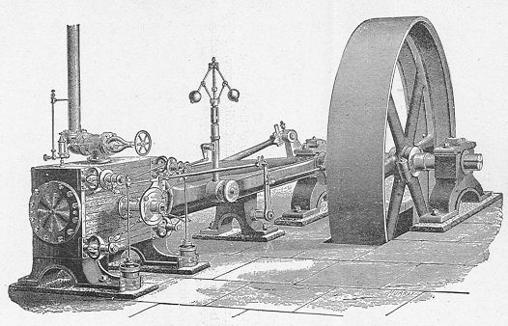
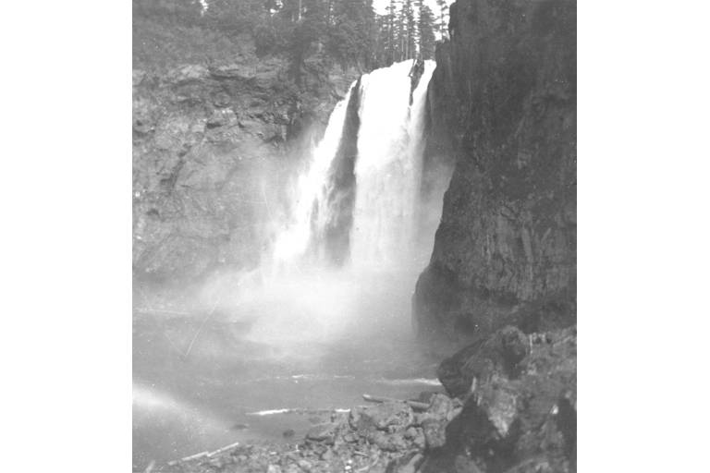
Part 1: The Early Years of Northwest Electricity (Prior to 1900)
Notes:
Picture Details:
Left: Drawing of a Corliss Steam Engine.
Source: Wikipedia
Right: Snoqualmie Falls ca1901
Source: University of Washington Digital Libraries

Slide 5
Part 1 Overview
Early power systems in the Northwest
The first electric loads
Structuring and financing the early systems
Local consolidation of the early systems and the shift to central generation

Slide 6
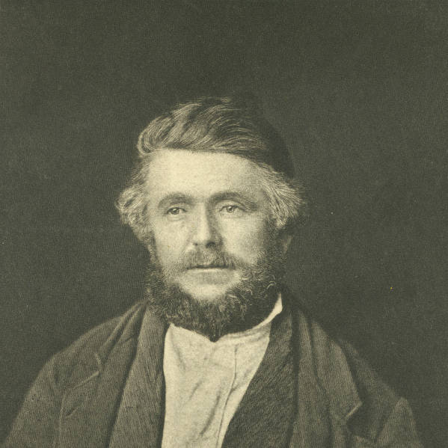
Early Hydraulic Systems
In 1845 Michael Simmons and a group of emigrants established the first permanent settlement of “Americans” north of the Columbia. The settlement was named New Market, now Tumwater.
This location was selected for 2 reasons:
One of the members of the party, Simon Bush, because of his ancestry was not allowed to own property under Oregon law.
The location had access to the Deschutes River.
After the first crop the settlement constructed a water wheel fed by a hollowed out log in order to grid their wheat into flour.
This type of hydraulic system was common throughout the Northwest and it was the first means to harness hydro power in a mechanical form.
Notes:
Picture Details:
Michael Simmons
Source: University of Washington Digital Libraries

Slide 7
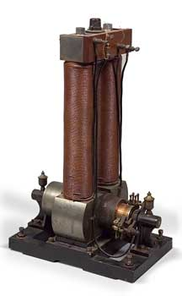
The First Electricity in the Northwest
In the summer of 1879 the SS California docked in Portland, Seattle did not see electricity for 2 more years when the SS Willamette anchored in Elliot Bay.
The SS California had six arc lights that were powered by the ships dynamos. This was the first form of electric lighting to reach the Northwest.
The SS California was equipped with arc lamps, incandescent light would not arrive for another year, aboard the SS Columbia.
At this time Portland had a population of 40,000, Seattle only 10,000, and the total Northwest was less than 500,000.
Notes:
Picture Details:
Photo of an Edison Long Legged Mary-Ann dynamo. These bipolar machines were generally 5-6 kW and produced 100V DC, primarily for lighting use. This is a picture of one of the four actual generators on the SS Columbia in 1880 for incandescent lighting.
Source: Edison Electric Institute

Slide 8
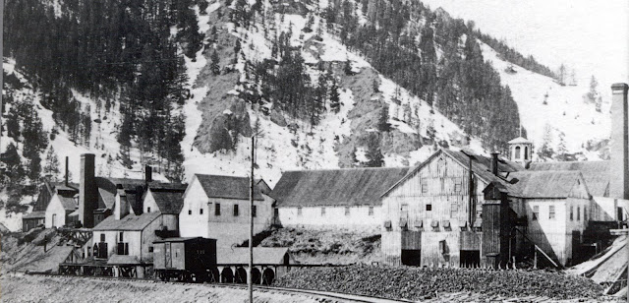
First “Central System” in the Northwest
The first Edison “central system” was built at the Philadelphia Companies Silver smelter in Ketchum Idaho in 1882.
The lighting provided by the system allowed the smelter to work around the clock, and two of the six lights were contracted for use by the city.
The smelter closed down November of the same year, and so did the central system.
The system proved so popular, and missed, that on Oct. 4th, 1886 the Boise City Electric Company was formed, and on July 4th 1887 the first light was lit.
The new system was powered by a small hydroelectric generator.
The city contracted for 10 lights at $3 a month.
Notes:
Picture Details:
Philadelphia Smelter. No date.
Source: Ketchum Sun Valley Historical Society

Slide 9
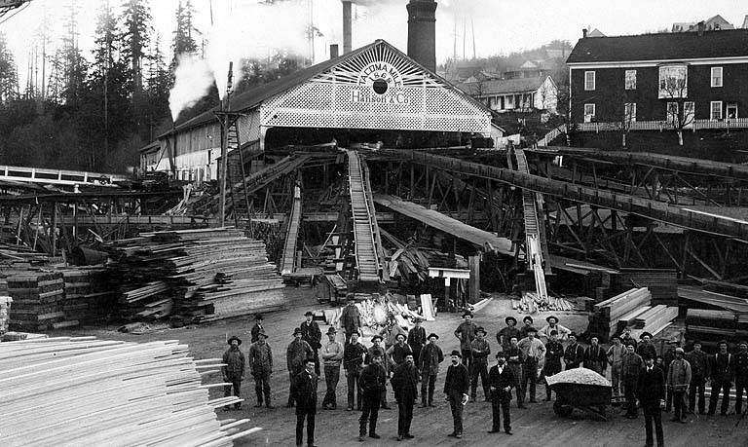
Electrification of Hydraulic Systems
The first water powered systems were mechanical hydraulic systems for performing work.
In 1882 the Tacoma Mill Company built a small plant on Galliher’s Gulch that included a dynamo to power a string of arc lamps, in addition to the existing mechanical load, so that workers could put in longer hours.
This was the first generator in the Washington Territory and the first example of using hydro for industrial, as well as electrical, purposes.
The power was only used at the mill, it was not transmitted any further.
For industrial locations that were already using hydraulic and/or steam, the addition of a dynamo was relatively easy.
Notes:
Picture Details:
Tacoma Mill Company, 1893. This was one of the first Northwest industrial facility to use arc lights.
Source: University of Washington Digital Libraries

Slide 10
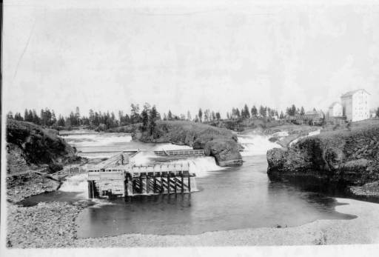
The first Standalone Hydroelectric System
While it was easy to electrify industrial facilities with existing hydraulic capabilities, not all locations had these.
The first hydroelectric plant, without a corresponding industrial facility, in the northwest was built at Spokane Falls in 1885.
A single water wheel provided the motive force for a single dynamo.
The dynamo powered 12 arc lamps.
Similar to the central systems, the generated electricity only supplied local loads.
Notes:
Picture Details:
C and C Mill at Spokane Falls. ca 1885. This was the first standalone hydroelectric facility in the Northwest.
Source: Spokane Public Library

Slide 11
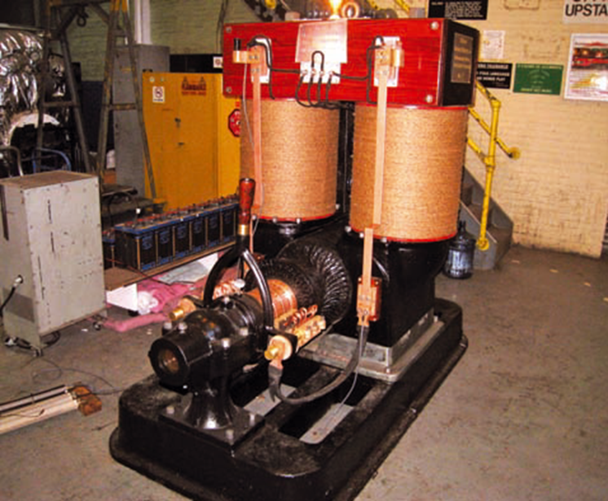
First Urban “Central System” in the Northwest
In 1885 Thomas Edison sent Sidney Z. Mitchell west to be the exclusive agent of the Edison Electric Light Company, he was 23 years old.
That same year Sidney Z. Mitchell and F. H. Sparling formed the Seattle Electric Light Company with a 25 year franchise, financed by the sale of 250 bulbs for a flat monthly fee per bulb.
The first full generation station was built on Jackson street with 2 steam Dynamos, 600 DC amp capacity, and on March 22, 1886 they demonstrated the first incandescent light bulb to be energized west of the Rocky Mountains by a fixed system.
This demonstration consisted of eleven 16 candlepower lights in the Seattle headquarters and occurred 5 months before Edison began operation of the Pearl Street Station.
Notes:
Picture Details:
Edison 100 kW Dynamo No. 16, originally installed at Edison's Brooklyn Pearl Street Station after a fire in 1890.
Source: Robert W. Lobenstein, “Saving History: the Story of Edison Dynamo No.16”, IEEE Power and Energy Magazine, Volume 10, Issue 3, pp. 72-82.

Slide 12
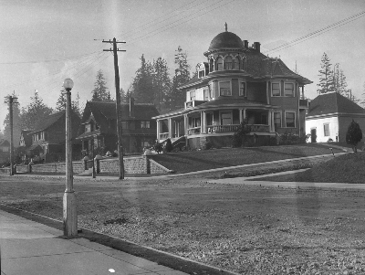
Early Electric Loads
The early systems were similar to modern demonstration projects, in that they were deployed at high costs to show the benefits that systems could provide.
In order to operate an electric utility successfully, there must be a paying customer base. As a result, a utility must understand the potential customer base.
The first common electric loads were lights, for which there were three primary uses:
Street lighting
Commercial lighting
Industrial lighting
After lighting, traction loads were the next most common for early systems.
Industrial motor loads for factories were still served primarily by steam or water, but there was some movement towards non-motor electrification.
Notes:
Picture Details:
Seattle Street Lighting ca 1900.
Source: City of Seattle Municipal Archives

Slide 13
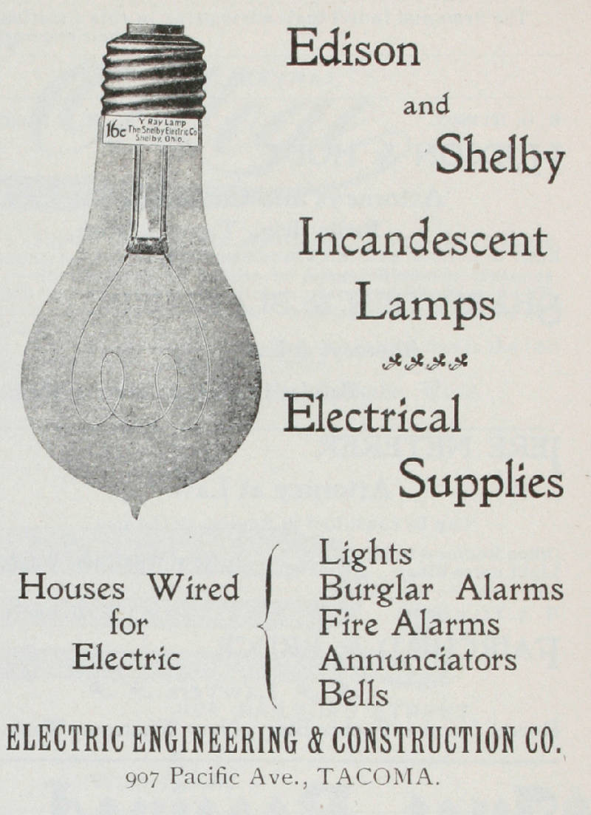
Early Lighting Loads
Street lighting was the first large scale electrical load and was the focus of early businesses.
These early systems provided street lighting and commercial lighting, residential lighting was initially very expensive.
Electric lighting was competing directly with gas street lights which had become a status symbol in affluent neighborhoods. The first gas street lighting franchise in Seattle was issued in 1873.
For electric lighting there were two competing electric light technologies.
Arc lamps: carbon arcs were the earliest example where an arc would be drawn between two carbon electrodes. Normal operation would consume the carbon.
Incandescent lamps: current would heat a wire to incandescence, but would not consume the wire.
Lighting was not billed with a service meter. Instead, common schedules were used (1885 Astoria rates):
10 o’clock lights $.75/light
12 o’clock lights $1.00/light
All night-lights $1.50/light (note: this is approximately $38.80 in 2012 dollars)
Notes:
Picture Details:
Edison and Shelby light bulb advertisement.
Source: University of Washington Digital Libraries

Slide 14
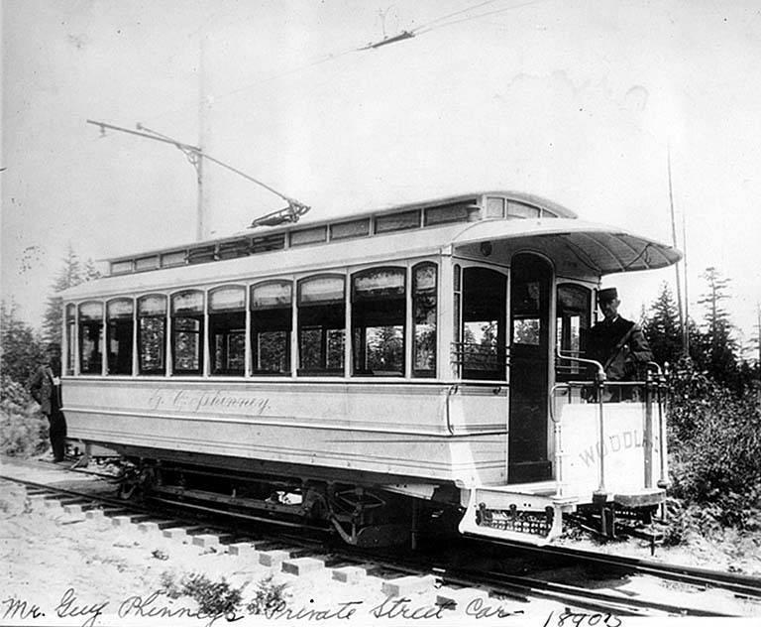
Early Traction Loads
Lighting generally only provided load during the evenings and nights, and as a result generating equipment was not making money during the day.
Electric street cars provided a load during the day, which increased the utilization factor of electric generation equipment. Thus making the systems more profitable.
Early electric street car were DC because of the ability to easily control the speed of DC motors.
Additionally, many street car lines were built specifically to provide transportation to new suburban communities.
Early traction loads were radial systems within urban centers or from urban centers to suburban communities.
Notes:
Picture Details:
Street car operated by Guy Phinney, Guy is seen on the car. Phinney Ridge, Seattle Washington.
Source: University of Washington Digital Libraries

Slide 15
Early Motor loads
Prior to 1890, factories tended to electrify with respect to lighting, motor loads electrified at a slower pace.
Early motor loads were limited because of the lack of a good motor design, it was not until 1886 that Frank Sprague invented a DC motor with limited sparking and provided constant speed under varying load.
High costs for buying and installing motors in conjunction with a lack of trained electrical engineers limited early adoption.
Because of the size of motor loads, they were often supplied by generating units within the factory. In some cases a single factory would require more power than the total capacity of the local utility.
By 1900 factories produced, and consumed, over half of the electricity in the United States, but less than 5% of factories were electrified.
Notes:
Circuit diagram for a cumulatively compounded DC motor. The interpole windings can be seen between the series winding and the armature. It was these windings that adjusted the armature distortion in the air gap, due to load, and helped reduce sparking.

Slide 16
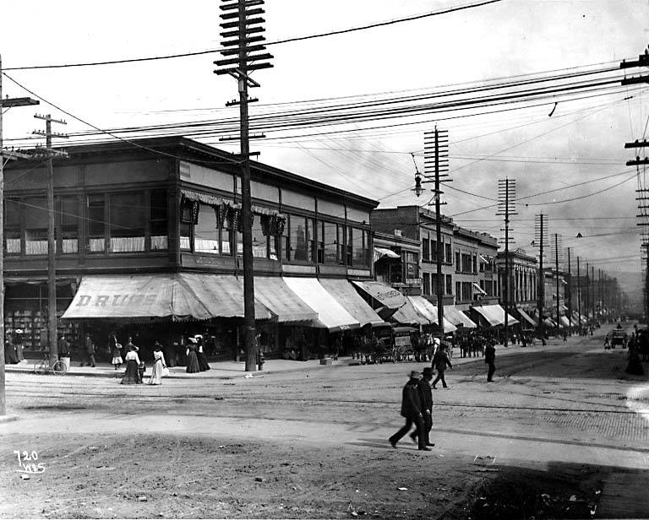
Municipal Regulation and the Franchise System
In order to connect the electrical generators with the end-use loads, it is necessary to run wires and cables, which required access to city streets.
In order to obtain the rights to use public right of ways for private use, a franchise was needed from the local municipality.
As a result, in addition to state level incorporation, utilities were required to obtain a franchise from the local municipality.
In many cases municipalities would issue short term, overlapping franchises with the idea that the market would determine the best price, capacity, ect.
The franchise system was not unique to electricity, and it experience corruption similar to other franchises such as water .
Notes:
Picture Details:
Utilities poles with multiple sets of distribution lines. Pike Street, Seattle Washington, ca 1905.
Source: University of Washington Digital Libraries

Slide 17
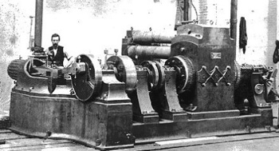
Financing the Early Power Systems
For new electrical systems, all of the infrastructure had to be built before there was a return on investment. As a result, the majority of early systems took on significant debt in order to begin operations.
Edison’s Pearl Street station required the invention of the Jumbo Dynamo, which was 27 tons and 150 kW. This was 4 times larger than any previous dynamo. The dynamos were named after the P.T. Barnum's famous elephant.
While the generators could be a significant cost because of their size, the largest cost was often the copper mains and distribution lines.
The franchise system with its uncertainty, and in some cases corruption, further increased the cost of operations.
The overall effect was that early power companies had a relatively low rate of return on large fixed investments, and if the franchise was lost the assets would be stranded. These were often high risk, moderate reward business ventures.
Notes:
Picture Details:
One of six of the Pearl Street Station Jumbo Dynamos, each was rated at approximately 100 kW.
Source: Edison National Historic Site.

Slide 18
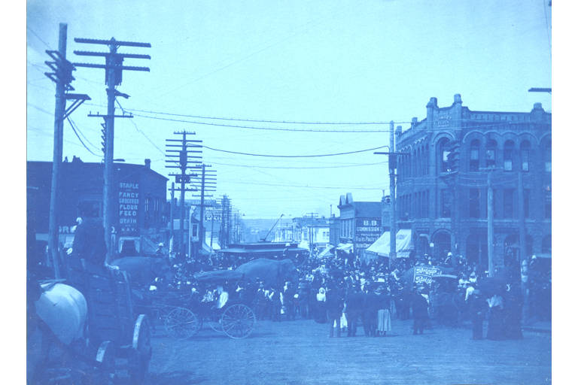
Growth of the Isolated Stations
Despite the challenges of financing new systems, the number of systems grew rapidly.
In the late 1900’s it was difficult to change DC voltage levels, so electricity had to be transmitted at close to the voltage at which it was consumed; resulting the need for many systems.
By 1899, within Seattle alone there were 12 electric utilities and 22 street car providers, all of which were private companies.
In the 15 years following the establishment of the Seattle Electric Light Company, Mitchell and Sparling built steam powered systems in Tacoma, Spokane, Portland, Bellingham, and many smaller towns in Washington, as well as Oregon, Idaho, and even British Columbia, Canada.
Notes:
Picture Details:
Bellingham Washington, 1900. (Note the elephant in the middle, Barnum & Baily was in town.)
Source: University of Washington Digital Libraries

Slide 19
Early Isolated Systems Across the NW
Washington:
1886 the first string of electric lights was energized in Seattle.
Seattle alone supported multiple private utilities.
Small steam systems supplying cities grew across the state.
Oregon:
1880 George W. Weidler built the first system at his Portland saw mill.
Additional systems were open in Portland, along with smaller systems across the state.
Idaho:
The first electric light in Idaho had been energized near Ketchum in 1882.
Small systems across the state began operation primarily to support mining interests.
Montana
Walkerville, a suburb of Butte, received the first electricity in the 1880’s.
Similar to Idaho, the majority of the early systems were operated to serve mining interests, the Anaconda Company being one of the largest.

Slide 20
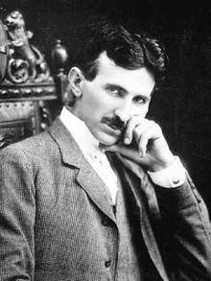
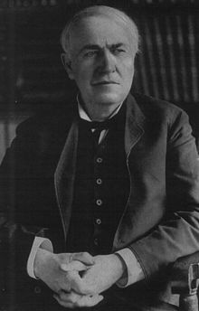
Battle of the Currents
While the early isolated electrical systems were DC, North America almost exclusively uses 60 Hz AC today.
For the early electrical systems, DC provided a number of benefits over the nascent AC systems, these included:
Worked well with lights and motors
Could be used directly with batteries
DC generators could be easily paralleled allowing multiple machine operations
Speed control is straight forward with DC motors
Edison had developed a customer meter for DC
Despite these benefits AC had a number of benefits that would win out in the long term:
Voltages can be changed using transformers
Higher voltages allowed for transmission over long distances with reduced losses
Poly phase machines were more efficient
At 60 Hz lighting flicker is not a problem
60 Hz works for lighting and motors.
Notes:
Picture Details:
Photos of Nikola Tesla (Alternating Current-Westinghouse) and Thomas Alva Edison (Direct Current)
Source: University of Washington Digital Libraries

Slide 21
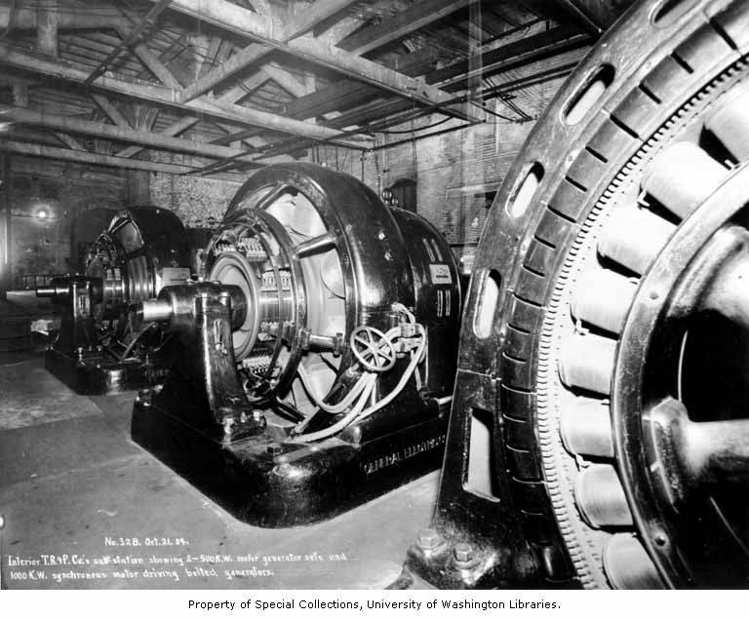
Battle of the Currents in the Northwest
In the Northwest ,the battle of currents was not nearly as contentious as it was in the eastern regions of the U.S.
Initially, many of the small isolated systems in the Northwest were DC because of Edison's effective marketing strategies.
Without high population densities, and with long distances between hydroelectric generation and load, expanding the early isolated systems was challenging.
In 1889 when Willamette Falls became the first AC hydroelectric plant in the nation, 2 phase, it was primarily because of the geography of the Northwest where the generation and load were separated by distance that were prohibitive for DC.
Where needed, DC could be obtained from AC through the use of motor generator sets, also known as rotary converters.
Notes:
Picture Details:
Motor generator sets at a Tacoma Power receiving substation, from Electron. ca 1904
Source: University of Washington Digital Libraries

Slide 22
Financial Panic of 1893
In the United States, the 1880’s was a period of rapid expansion, this included the Northwest. There were numerous electric companies started to provide, lighting, traction, and power, which were heavily financed.
The panic was caused by the collapse of railroads overbuilding in conjunction with questionable financing that resulted in a series of bank failures.
Additionally, the Sherman Silver Purchase Act of 1890 had the government buying silver to drive up the price. Eventually the U.S. reached the minimum gold limits and U.S. notes could not be redeemed for gold.
This resulted in many investments of the era being financed with high interest bonds, including the newly started electric companies.
As a result, many of the newly started companies were wiped out by the panic.

Slide 23
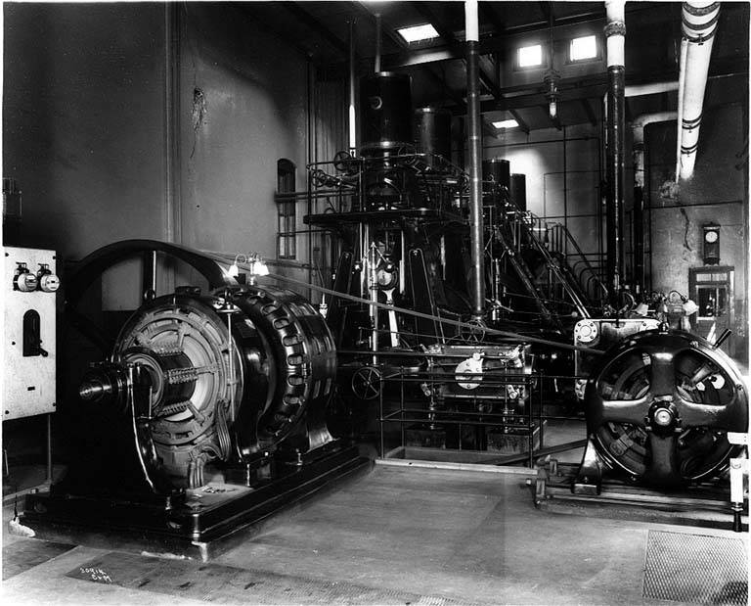
The Collapse of the Early Systems
In addition to the unsound financial basis of many of the early electricity companies, there were technical issues that made them unviable.
One of the largest problems was the amount of capital investment required by each company.
Each company maintained its own generation for a relatively small amount of load. Because of the need for duplicate equipment, economies of scale could not be taken advantage of.
High capital cost are still a defining characteristic of the modern electric power system.
While the systems collapsed financially, their infrastructure was still in place.
Notes:
Picture Details:
Seattle Brewing and Malting Company ca 1914. This is an example of the generators required for a small system; a stand alone industrial system in this case.
Source: University of Washington Digital Libraries

Slide 24
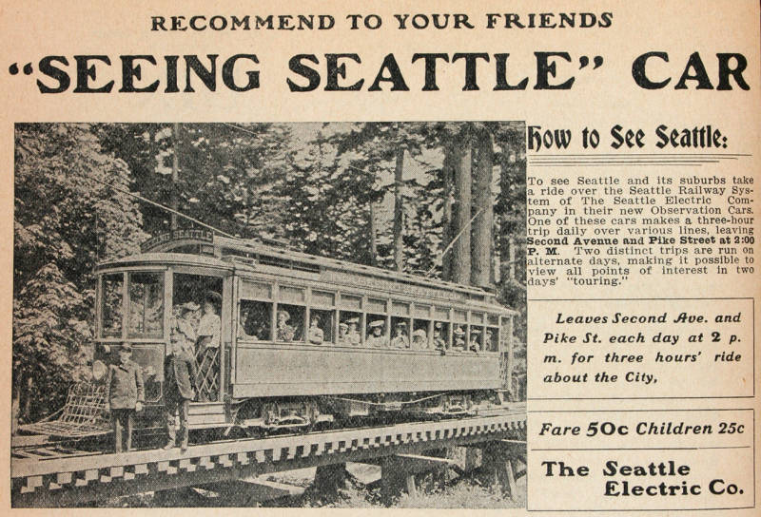
Local Consolidation of the Early Systems
While the panic of 1893 resulted in the failure of many electric utilities, there was still a demand for service which, presented the opportunity for consolidation.
By 1900, most of the isolated systems in Seattle were purchased and consolidated by Stone & Webster, under the Seattle Electric Company (SEC). This also included 22 electric street car lines. Other regions saw similar consolidations.
Stone & Weber was one of the nations earliest electrical engineering consulting firms in the nation, but they acted very much like a holding company.
Consolidations under the Seattle Electric Company represented consolidation at the local level, within a small geographic region.
Consolidation at larger levels would have to wait for the proper business environment, and the necessary technical advances.
Notes:
Picture Details:
Advertisement for the one of the Seattle Electric Companies street cars. In 1901 SEC owned all 22 of the cities street car lines.
Source: University of Washington Digital Libraries

Slide 25
Formation of the Seattle Electric Company
Notes:
Picture Details:
The companies that formed the Seattle Electric Company in 1900, a Stone & Webster.
Source: Duplicated based on Neil McReynolds, “A Century of Service, The Puget Power Story”

Slide 26
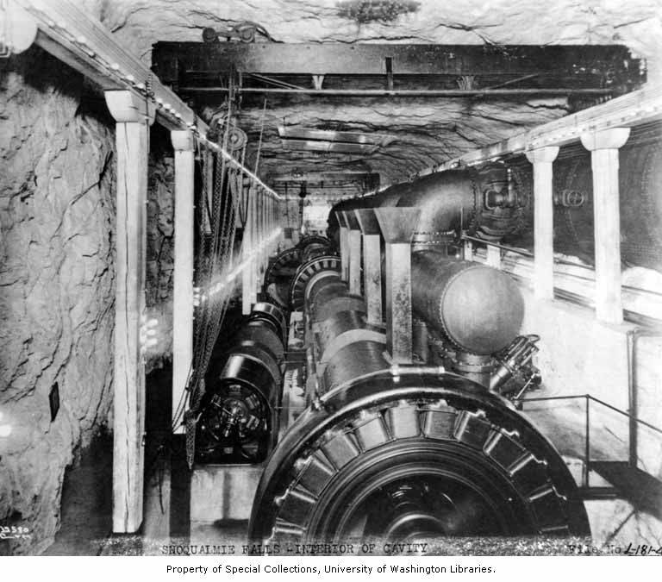
The Rise of Larger Generation Stations
Prior to consolidation, each individual company provided enough generation to meet load plus losses. This resulted in a significant amount of duplication, and machines running at inefficient levels, especially steam units.
One the numerous failed smaller companies were consolidated, it was necessary to develop larger and more efficient generators to supply the load.
One of the first large generation stations that would supply multiple companies was the Snoqualmie Falls Power Plant.
Originally envisioned by Charles Baker in the 1880’s, Snoqualmie Falls began operation in 1898 with 4 1,500 kW turbines. Each unit was 10 times larger than the Jumbo dynamos that Edison used at Pearl Street Station 15 years earlier.
32,000V AC lines ran from the power house to Seattle (32 miles), Tacoma (44 miles), Everett (36 miles), and locations in between.
Notes:
Picture Details:
Interior of the Snoqualmie Falls underground chamber. No Date.
Source: University of Washington Digital Libraries

Slide 27
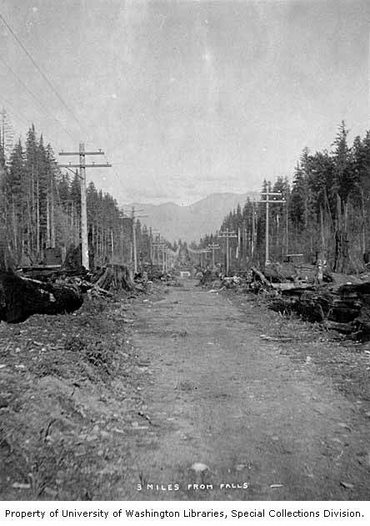
The Closing of the 19th Century
At the end of the 19th century, private companies were the primary providers of lighting, traction, and power. They operated based on franchises received from municipalities, and they were vertically integrated companies.
Local consolidation of electric utilities was underway in Washington and Oregon, but had not occurred at a significant level in Idaho and Montana because of low load densities.
Consolidation had lowered costs ,but electricity rates were still significantly higher than they are today. Additionally, many of the electric companies were owned through Stone and Weber, which was an “East Coast Concern” and was not perceived by the public as having the regions best interest in mind.
Centralization was the new operational model and generators were becoming larger and line voltages were increasing to accommodate the larger transfers of power.
By the end of the 19th century, the Northwest Territories had become states:
Washington: Because the 41st State Nov. 11^{th,} 1889
Oregon: Became the 33rd State Feb 4th 1859
Idaho: Because the 43rd State July 3rd, 1890
Montana: Became the 42nd State Nov. 8th, 1889
Notes:
Picture Details:
Road to Snoqualmie Falls, including the power lines connecting the generators. 1901.
Source: University of Washington Digital Libraries

Slide 28
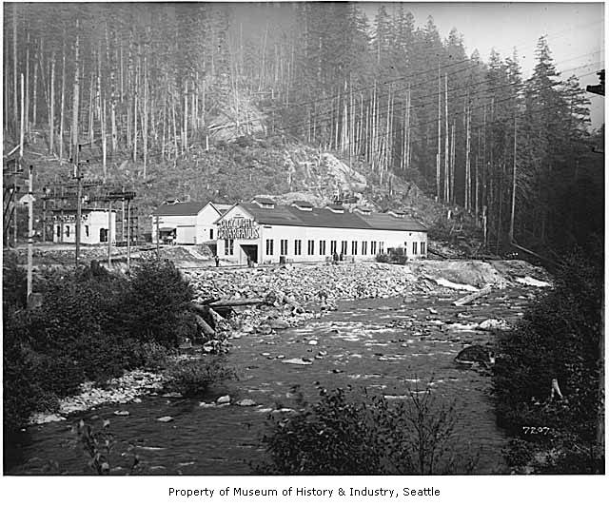
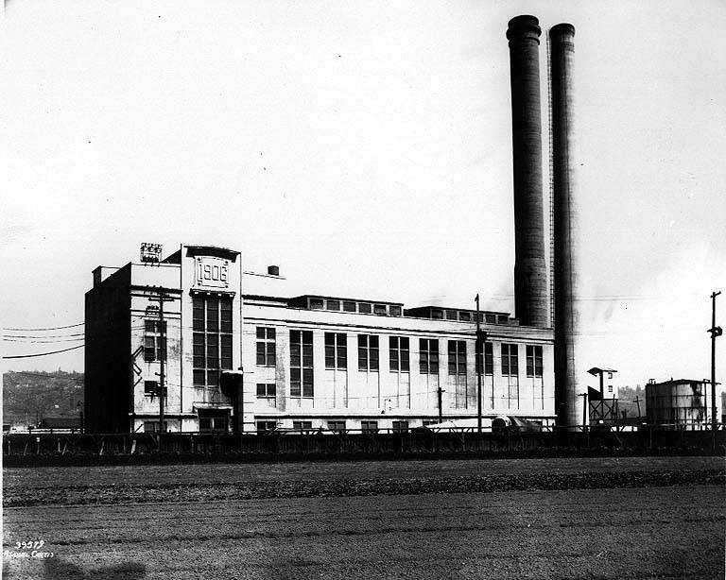
Part 2: Private Companies and Municipal Power (1900-1930)
Notes:
Picture Details:
Left: Cedar Falls power house 1912. Operated by Seattle Water Department, and later by Seattle City Light, this was the first municipal dam for power production.
Source: University of Washington Digital Libraries
Right: George Town Steam Plant 1920, Seattle Washington. Built by the Seattle Electric Company in 1909 it was constructed to provide AC power for the city of Georgetown, and DC power for the interurban railway between Seattle and Tacoma.
Source: University of Washington Digital Libraries

Slide 29
Part 2 Overview
Regional consolidation of utilities
The emergence of Municipal power
New technologies
Electric loads
Introduction of utility regulation at the state level

Slide 30
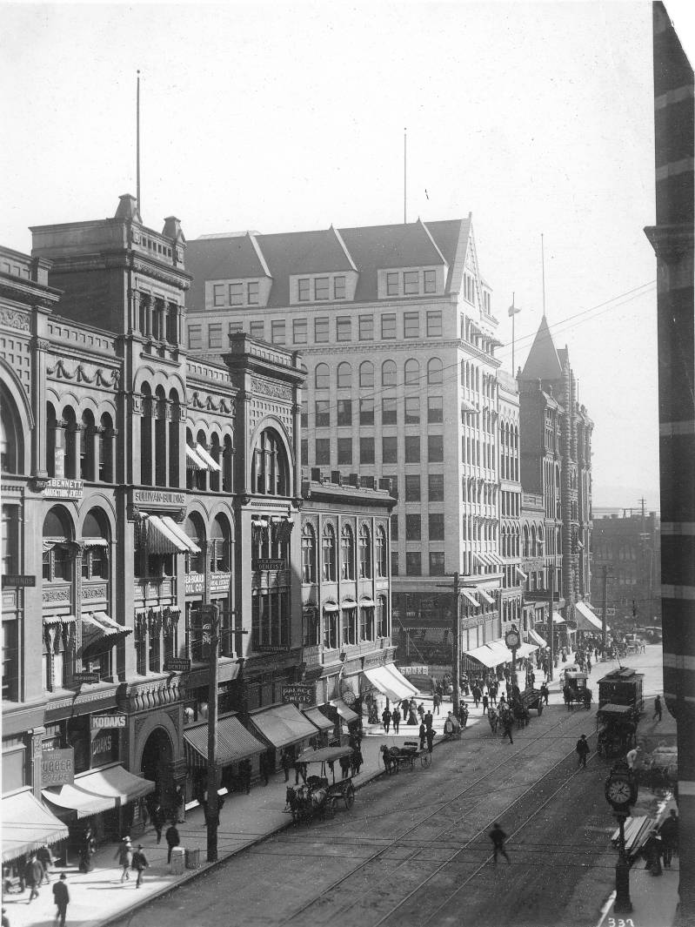
Northwest Electricity Industry in 1900
Washington:
The majority of power providers were private companies such as the Seattle Electric Company.
There were a few municipal companies, such as McMinnville Water and Light and Tacoma Power, which were founded in 1889 and 1893 respectively.
The states first hydroelectric facility at Snoqualmie Falls had been completed in 1898.
Oregon:
Similar to Washington the majority of power providers were private companies such as Portland General Electric.
Milton-Freewater City Light & Power was the only Municipal power provider in the state, having been formed in 1889.
Willamette Falls had been in operation for over a decade.
Idaho:
The first electric light had been energized near Ketchum in 1882.
In 1900 numerous small utilities served load across the state, it was not until just prior to 1915 that significant consolidation occurred.
Many of these utilities were opened to serve mining interests.
Montana:
Walkerville, a suburb of Butte, received the first electricity in the 1880’s.
Mining prospered in Montana as the demand for copper increased.
Similar to Idaho, many of these utilities were opened to serve mining interests, the Anaconda Company being one of the largest.
Notes:
Picture Details:
Seattle Washington, 1st Ave looking south.
Source: University of Washington Digital Libraries

Slide 31
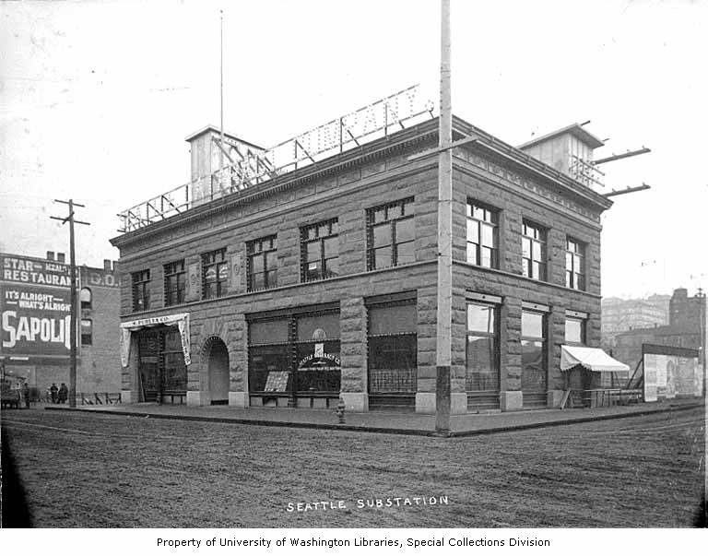
The State of Private Power in 1900
At the turn of the century, private power systems in the U.S. represented more than 90% of total electricity produced. This number was even higher in the Northwest where cities were still relatively small and Municipal systems were not able to compete with private companies.
The small isolated private utilities of the previous century had begun to grow in size because of economic pressures, and technical trends.
Industrial loads, often served by on-site generation, were beginning to grow in size to keep pace with the growing industrial base of the nation.
Heavy industry often had to produce it own electricity because their load could exceed the local utilities capacity.
Private companies aggressively pursued lucrative city franchises with their higher load densities and often ignored low density rural areas.
As a result of consolidation, electricity rates began to decrease, but were still high by todays standards.
Notes:
Picture Details:
Snoqualmie Falls Power Company Seattle substation, ca 1901.
Source: University of Washington Digital Libraries

Slide 32
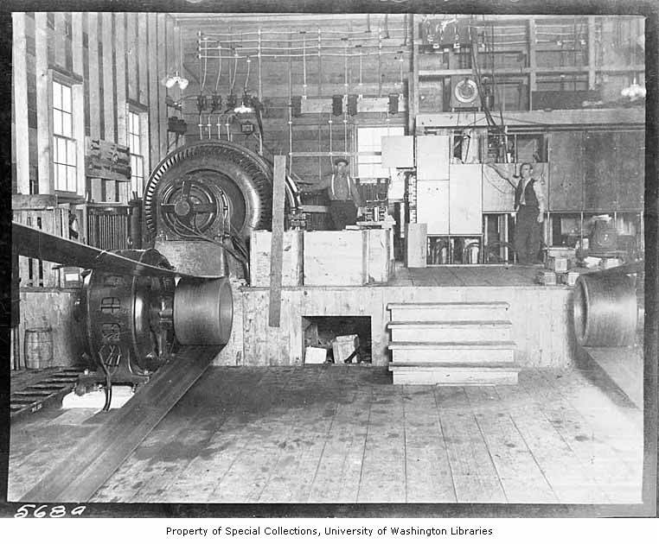
The Emergence of Municipal Power
Despite the lowering electric rates provided by private utilities, there were people who felt that the companies were still making larger than appropriate profits.
In 1902 the voters of Seattle approved a $590,000 bond for the construction of a municipal dam on the Cedar Creek that would operate in direct competition with private utilities.
In 1905 Cedar Falls began operation and was the first municipally owned hydroelectric plant in the nation. It produced 2,400 kW for Seattle street lights and was run by the water department
The Seattle Electric Company had been supplying power for 20 ₵/kWh, within a year of Cedar Falls beginning operation, SEC cut their rates in half to compete with Cedar Falls 8.5 ₵/kWh.
1910 saw the formal formation of Seattle City Light, which took control of Cedar Falls from the Water Department.
The competition between the new municipal system in Seattle and the existing private systems, reflected the question being asked on a national level “is public or private power better?”.
Notes:
Picture Details:
Interior of the Cedar Falls Power Plant, 1912. Operated by Seattle Water Department, and later by Seattle City Light, this was the first municipal dam for power production.
Source: University of Washington Digital Libraries

Slide 33
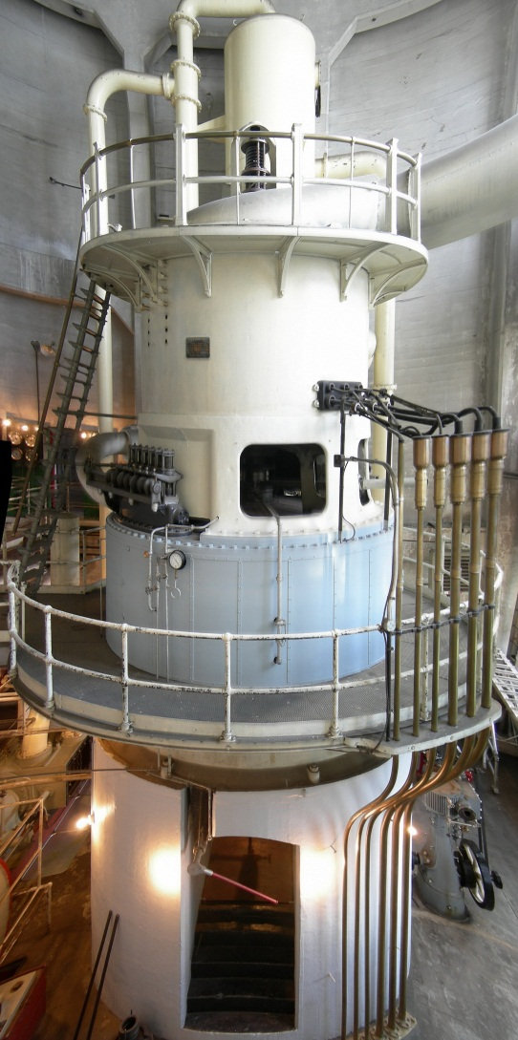
The New Technologies
For the private utilities, as well as the emerging municipal utilities, the technology of electricity determined what was financially viable.
In the previous century, electric companies had used the first generation of electrical equipment to enabled the small isolated systems.
Steam engines
Dynamos
Low-voltage DC systems
In the 20th century, the next generation of technologies allowed for large interconnected power systems that resemble what the industry uses today.
Steam turbines
Generators
Multi-voltage AC systems
These new technologies not only changed the electrical industry, but also had a profound impact on society. Greater access to electricity changed the way that people lived.
The new technologies benefited private companies and municipal systems.
Notes:
Picture Details:
Georgetown Steam Plant, Seattle Washington. An example of a vertically mounted steam turbine, the first generation of generators to replace steam engines.
Source: Wikipedia

Slide 34
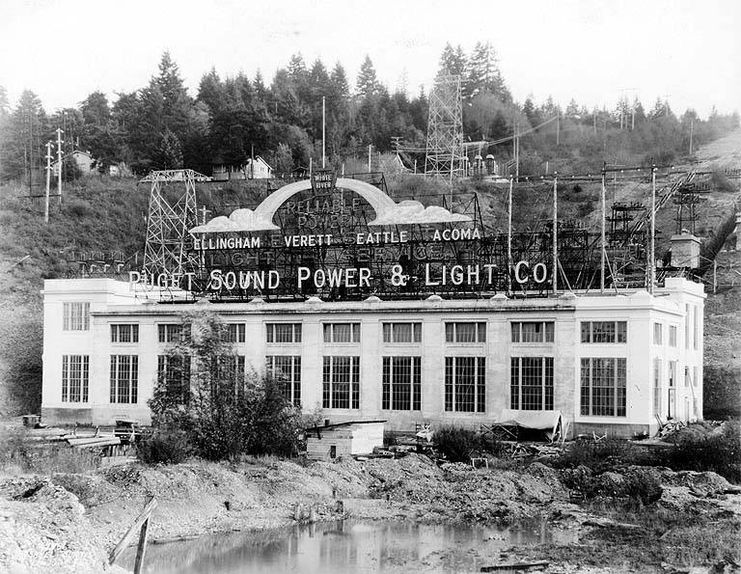
Regional Consolidation of Private Utilities
Shortly after the establishment of Seattle City Light in 1910, further consolidation of private power in Washington occurred with the incorporation of Puget Sound Traction Light & Power Company in 1912.
Consolidation in 1912 was at a regional level, that was made possible by large new generators and their interconnecting 55,000V AC lines.
4 Hydro plants
Snoqualmie falls (6 MW, 44MW by 1954)
White River (20MW, 65MW by 1914)
Electron (Currently 22MW)
Nooksack
Steam plants
Georgetown - Seattle
Post street - Seattle
York Street - Bellingham
Regional consolidation is something that the Municipal utilities did not have the authority to do, since it covered areas outside of municipal boundaries.
Notes:
Picture Details:
Puget Sound Power & Light Companies White River Hydroelectric Project. 80,432 HP (59.98 MW). Ca 1925
Source: University of Washington Digital Libraries

Slide 35
Formation of Puget Sound Traction Light & Power Company
Notes:
Picture Details:
The companies that formed the Puget Sound Traction Light & Power Company in 1912.
Source: Duplicated based on Neil McReynolds, “A Century of Service, The Puget Power Story”

Slide 36
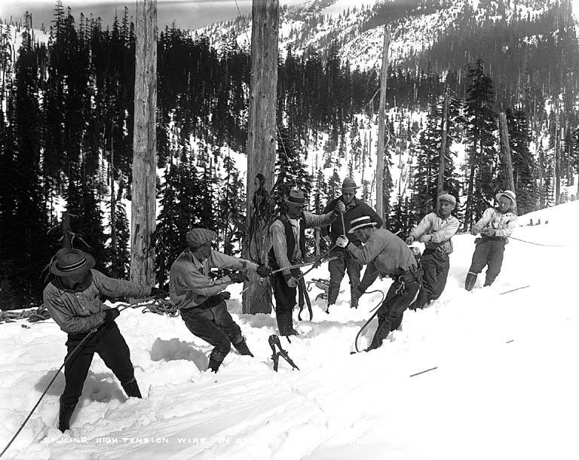
Benefits of Regional Consolidation
Regional consolidation had a number of benefits from both a technical, as well as financial perspective.
Technically, larger generators and interconnections allowed for fewer units to be running at any given time, which increases reliability and reduces cost.
The first power line across the Cascades was built in 1922. This allowed power from dams on the eastern side of Cascades to power the load centers on the western side of the state.
Financially, consolidation allowed for more efficient financing of new infrastructure. With more capital assets, it was possible to finance larger projects.
The early regional consolidation, with its larger generators and interconnected regions, laid the foundation for the infrastructure that is operated in the Northwest today.
Notes:
Picture Details:
Stone & Webster crew running lines over Stevens Pass, ca 1927.
Source: University of Washington Digital Libraries

Slide 37
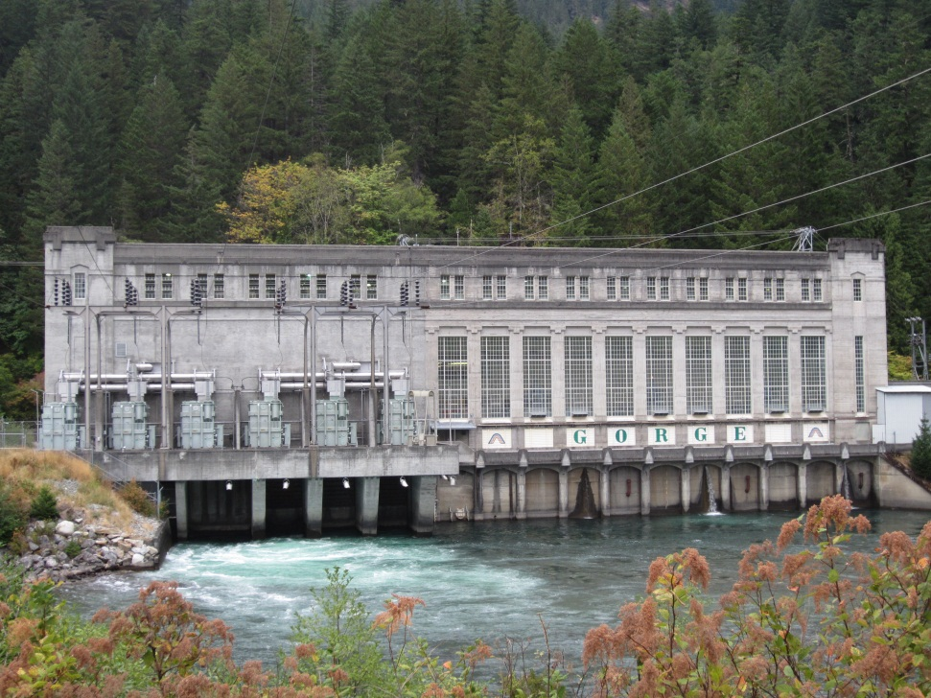
SCL Learns from Regional Consolidation
The city of Seattle may have built the first municipal dam in the country, but demand soon out grew the capacity.
The second superintendent of SCL, J.D. Ross, while not a proponent of private power, did see the benefits of the consolidated model.
In order to meet the demand for new generation, SCL looked north to the Skagit river valley; this was to become the Skagit River Hydroelectric Project.
Initial federal approval was given in 1918 after Stone and Webster's permits for construction had lapsed for a second time. Ross had tried in 1916, but the Stone and Webster permits were extended. The second time Ross went directly to the Secretary of Agriculture to deliver the SCL application to build dams.
The interactions between Stone & Webster, and J.D. Ross were never collaborative, and often acrimonious.
From 1921-1949 SCL built three new dams.
1924 Gorge Dam
1936 Diablo Dam
1949 Ross Dam (originally Ruby Dam but renamed)
Power was received in Seattle at the North Substation north of Green Lake, 165 kV.
Rates fell to 3.41 cents per kWh in 1925 because of the abundance of new generation at George Dam.
Notes:
Picture Details:
Gorge dam power house, 199.2 MW. ca 2012.

Slide 38
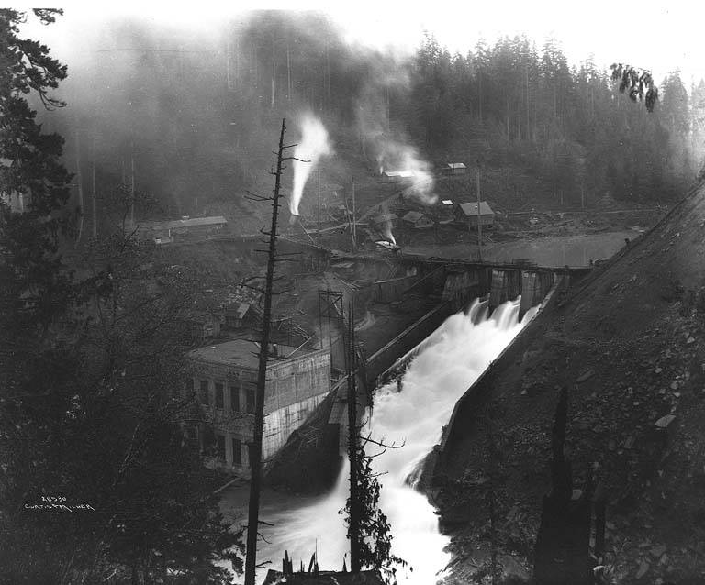
Other Regional Dams
In addition to the Skagit River Hydroelectric Project, there were a number of other smaller dams build around the region.
Since utilities were still vertically integrated, it was not cost effective for companies to build transmission lines for each of these small dams. As a result, they generally supplied local loads.
Two examples are:
Elwha Dam: built by the Olympic Power and Development Company, it had a 25 MW capacity and began operation in 1913.
Condit Dam: built by the Northwestern Electric Company, it had a 14.7 MW and began operation in 1913.
Today, some of these dams are being removed to restore the local environment. This is viable because of their relatively small output.
While these dams are small, the loss of generation must be offset be other sources.
Notes:
Picture Details:
Elwha dam and power house, 1914.
Source: University of Washington Digital Libraries

Slide 39
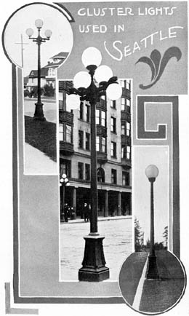
Electric Loads in the Early 20th Century
In the early 20th century, there was significantly more load to serve than in the previous century.
The companies that consolidated out of the early financial collapse aggressively sought to increase their service base.
If a company could increase it’s load base, and level it out, it would be more cost effective. Favorable financials made financing easier to come by.
There were three factors that allowed private utilities to supply higher levels of load:
Consolidation
Alternating current
Steam turbines
Similar to the last century, the three main load types were:
Consumer (Residential)
Traction (Street cars)
Industrial (Motors)
Notes:
Picture Details:
Source: University of Washington Digital Libraries

Slide 40
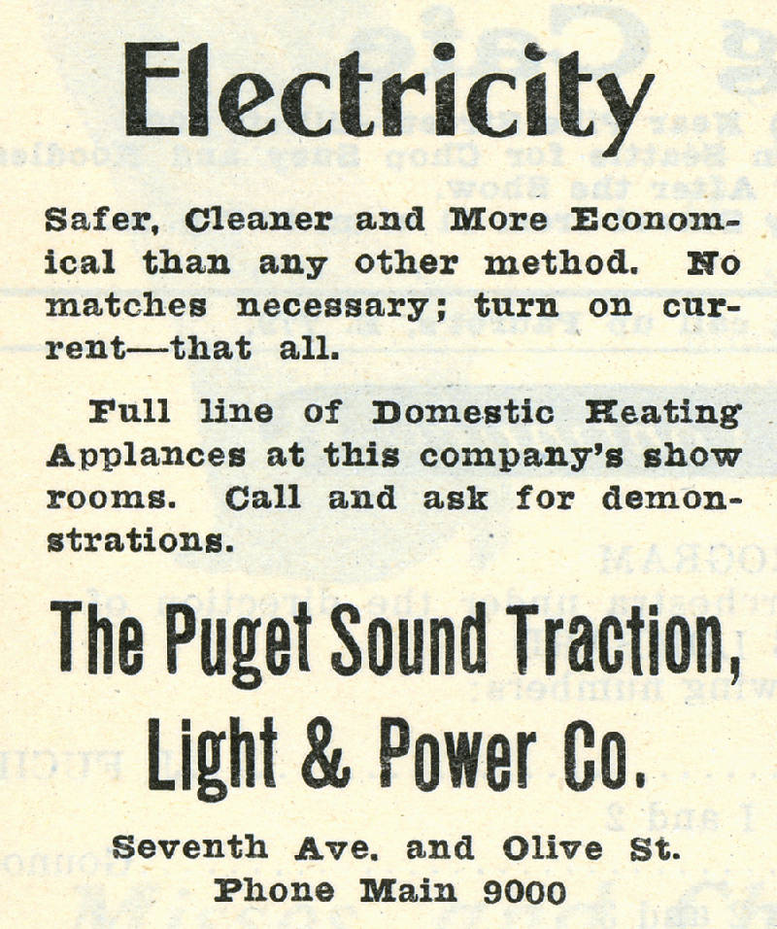
Consumer Loads
In order to encourage the residential use of electric appliances, utilities would advertise the benefits of electricity.
While early residential service primarily focused on lighting, new loads such as irons and cooking implements were popular.
In some cases, utilities would give appliances away to grow their customer base.
In addition to giving appliances away, advertising the new life style promised by electricity was common. The lifestyle was generally in comparison to the current state of the art, gas lighting which was hot and dirty.
As the new conveniences because more popular, they quickly grew in number, bolstering the utilities load base.
Notes:
Picture Details:
Metropolitan Theater, now the Metropolitan Opera, Program p.32, 1918.
Source: University of Washington Digital Libraries

Slide 41
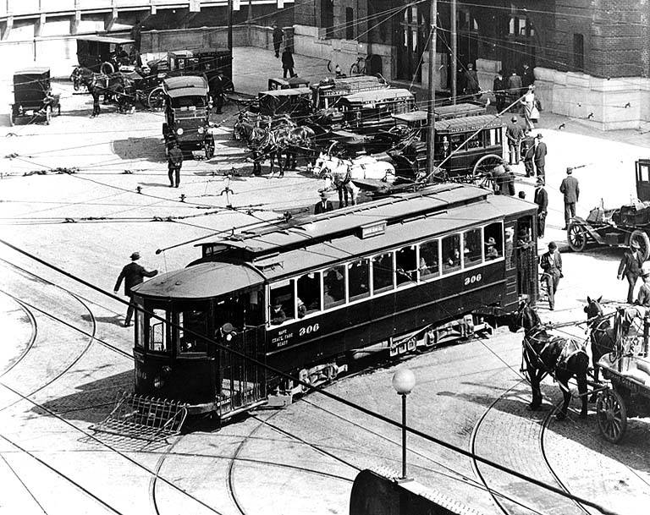
Traction Loads
Because of improved electric motors, electric street cars of the 20th century were significantly larger than those of the previous century, and they operated in networks as opposed to the early point to point systems.
Electric street cars operated in large transportation systems that included interurban service.
These systems were often operated in conjunction with amusement parks in order to create a more constant load.
For this reason, many electric utilities owned street car lines and amusement parks.
Traction loads were significant sources of revenue into the 1930s, when they began to be replaced by automobiles.
Notes:
Picture Details:
4th and Jackson next to Union Station, Seattle Washington. 1913.
Source: University of Washington Digital Libraries

Slide 42
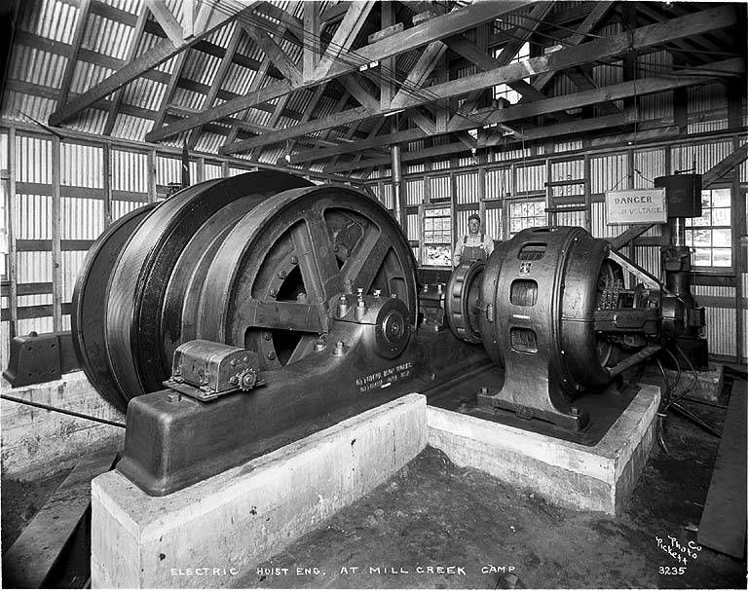
Industrial Loads
As electric motor designs improved, they were quickly adopted for industrial applications.
Factories initially used large individual motors to drive pulley systems, but eventually moved to smaller, more efficient, individual motors.
In 1900 less than 5% of factories were electrified, but this had increased to over 75% by 1930.
In 1907 factories produced 60% of all electricity used in the nation. This was because some factories had electrical loads that exceed the capacity of the local utility.
As utility systems consolidated and their capacity grew, they picked up more factory loads, and the number of factories that produced their own electricity decreased.
By 1930, utilities produced over 75% of the electricity in North America, including most of the industrial loads in factories.
Notes:
Picture Details:
Electric hoist at Mill Creek construction camp. During construction of the Cascade Tunnel at Stevens Pass, ca 1926.
Source: University of Washington Digital Libraries

Slide 43
Problems with the Municipal Franchise
While the growth of electricity consumption was increasing in all aspects of society, the franchise system was viewed as an obstacle to growth, and not an enabler.
The uncertainty of the franchise system limited the profitability of private systems, and did very little to safe guard the customers.
In numerous cases, there was extensive corruption in the franchise system. With no accountability above the city level, a relatively few number of people could make significant profits through questionable practices.
In 1898, in an address before the National Electric Light Association (now the Edison Electric Institute), Samuel Insull proposed that electric companies be regulated at the State level. There were two primary reasons why Insull proposed state level regulation:
First: The complicated franchise system made it difficult to run a business. The high capital cost, low rate of return, and uncertainty in the franchise system made financing difficult. Insull believed that uniform regulation across a state would make for a more stable business environment.
Second: There was a trend toward municipal power in response to the practices, real or perceived, of private power. It was thought that if there was a regulatory body with the interests of the customer in mind it might reduce enthusiasm for municipal power.
The short falls of the Franchise system were affecting not only private companies, but also the customers they served.
Despite this, there was not an immediate movement to regulation at the State level.

Slide 44


Transition from Municipal to State Regulation (1907-1914)
The era of municipal franchises started to end when the first State Commissions were formed in New York and Wisconsin in 1907.
The goal of State level regulation was to create a uniform regulatory environment state wide, and to better protect the interests of the consumers.
The Wisconsin model allowed Municipalities to terminate franchises, and purchase the system assets. The model became a common template for other states and by 1914 29 states had commissions whose authority superseded that of the municipalities.
In general, commissions allow utilities to recover money, via sales, that were equal to the cost of operation plus a “reasonable rate”.
Today private power companies in the NW are regulated by their state utility commissions:
Washington Utilities and Transportation Commission (1909)
Oregon Public Utility Commission (1911)
Idaho Public Utilities Commission (1913)
Montana Public Service Commission (1913)

Slide 45
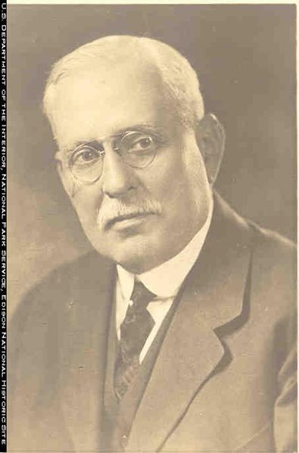
State Regulation and the Holding Companies
With regulation occurring at the state level, it was possible to put numerous companies under a single corporate umbrella.
Holding companies allowed utilities to consolidate resources across a larger base that allowed for more effective financing, as well as sharing of resources.
While the individual utilities were subject to state regulation, holding companies were interstate entities and as such were not subject to state regulation.
While there were legitimate reasons for holding companies, there were individuals and groups who used holding companies with detrimental consequences.
In some cases, a single utility could be at the bottom of 10 layers of holding companies.
Notes:
Picture Details:
Photo of Samuel Insull, a vocal advocate for state level regulation.
Source: University of Washington Digital Libraries

Slide 46
Public and Private Power at the end of 1929
The competition between public and private power was as much a matter of service as it was of perception.
Private power continued to grow and consolidate, often as part of a larger holding company.
While it was private businesses that started the electricity industry in the Northwest, the fact that it was often run from the East Coast, and not locally, was a public relations issue in the West.
Urban electrification was well underway, rural regions had little or no access to electricity. Municipalities could not serve them and private companies often would not.
The Great Depression had just begun with the Stock Market Crash of October 29th 1929.
Notes:
Picture Details:
Seattle Washington, 1st Ave. looking north, 1935. Equipment of Seattle City Light and Puget Sound Energy on the same pole.
Source: University of Washington Digital Libraries

Slide 47
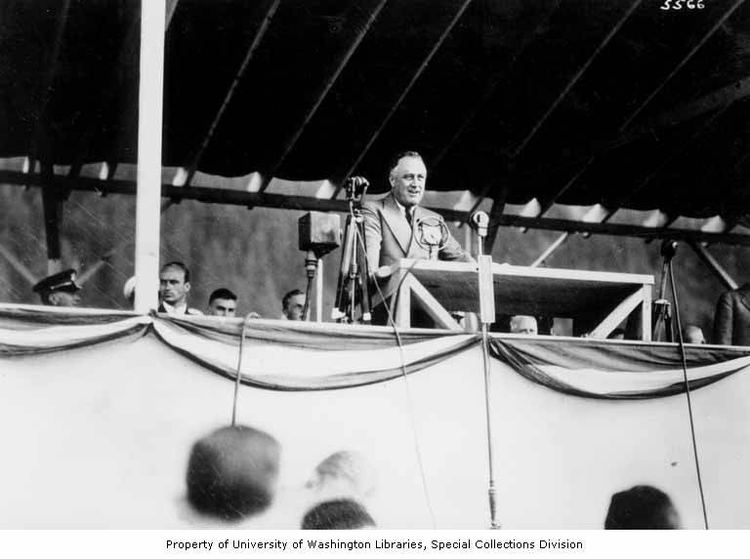
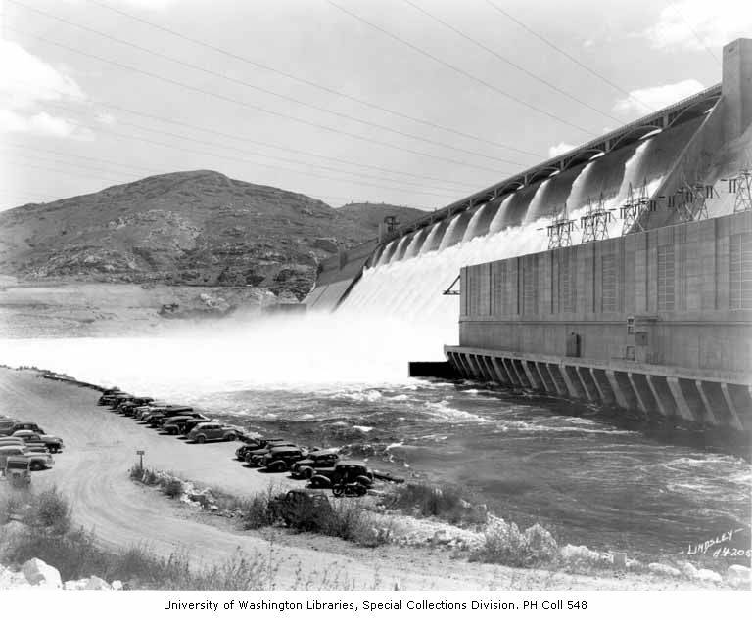
Part 3: The Emergence of Federal Power (1930-1950)
Notes:
Picture Details:
Left: Franklin D. Roosevelt at the opening of Bonneville Dam, 1937.
Source: University of Washington Digital Libraries
Right: Grand Coulee Dam, 1945.
Source: University of Washington Digital Libraries

Slide 48
Part 3 Overview
Why the federal government became involved in the electricity industry
Rural electrification of the Northwest
Bonneville Power Act
Formation of Public Utility Districts
Federal Power and the Second World War

Slide 49
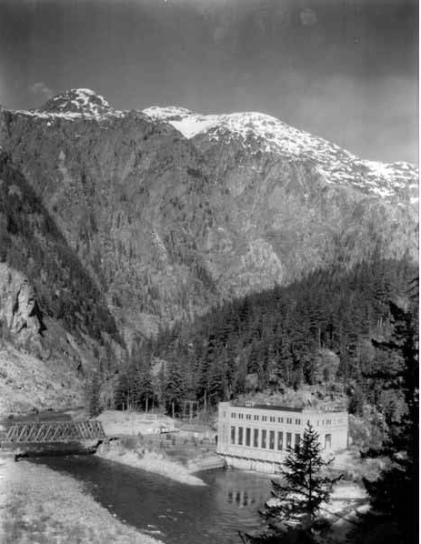
Northwest Electricity Industry in 1930
Private companies were continuing to expand, enabled by new technologies, but there was a growing public disdain for private power companies.
90% of urban centers had access to electricity while <10% of rural areas did. Private companies in Washington state had a much higher percentage, but still far below urban levels.
In 1929 the Army Corp of engineers had published their 308 report, that recommended the construction of 10 dams on the Columbia, but construction had not begun. The 308 report was so named because it was document No. 308 for the first session of the Sixty-ninth Congress.
The stock market had crashed in October 1929 and the Smoot–Hawley Tariff Act had been passed, the Great Depress had begun.
Notes:
Picture Details:
George Power house, ca 1930.
Source: University of Washington Digital Libraries

Slide 50

Why the Federal Government Became Involved
As previously discussed, Municipal utilities often formed in response to private utilities. Because of concerns regarding the franchise system, the regulation of utilities had moved from a municipal to a state level.
Utilities were regulated based on the state that they were located in.
Large holding companies were used to circumvent the power of state level regulation, while at the same time state level regulation was used to guaranty a favorable business environment.
Additionally, large portions of rural America still did not have access to electricity.
As a result of the actions of large holding companies, and the Great Depression, the federal government became involved in the electricity industry; for the Northwest this took the form of the Bonneville Power Administration.

Slide 51

Public Utility Holding Company Act of 1935
By the early 1930’s a small number of large utility holding companies controlled approximately ¾ of the investor owned electric utility industry.
Regulation allowed utilities to recover a “fair” return on their rates. The unregulated holding companies would sell services to their regulated utilities at inflated rates, which was effectively bypassing the existing state level regulation.
The Great Depression, heralded by the Stock Market Crash of 1929, caused a number of the holding companies to fail.
In response to the Great Depression, and the perception of the utility holding companies were harming the public, the Public Utility Holding Company Act of 1935 was passed.
Holding companies were to be regulated by the Security Exchange Commission (SEC)
Prevented regulated utilities from engaging in unregulated activates, e.g. streetcars subsidiaries.
The Public Utility Holding Act was in place until it was replaced in the Energy Policy Act of 2005.

Slide 52
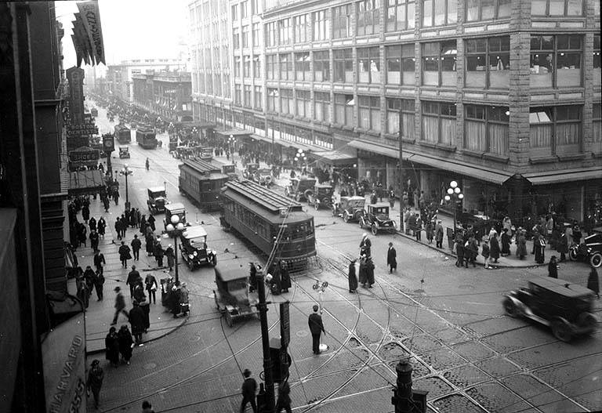
Utilities Divest from Unregulated Activities
A provision of the Public Utility Holding Company Act of 1935 that had a major impact on utilities was the requirement that utilities could not engage in unregulated activities.
Utilities had been using non-regulated industries such as street cars and amusement parks as a load balancing mechanism for weekends. While most electric parks were gone by 1917, it was the traction loads that were the most affected.
In some cases the street car companies were heavily subsidized by their parent utilities because of the load balancing they provided.
Forcing utilities to divest from street cars was another contributing factor to the rapid disappearance of traction loads.
The last mainstream street car ended operation in Seattle on April 13th 1941.
Notes:
Picture Details:
Seattle Washington, 2nd Ave from Pike St. ca 1920
Source: University of Washington Digital Libraries

Slide 53
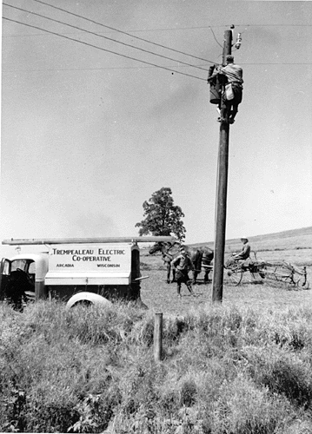
The Rural Electrification Act of 1936
Because of the population density of urban centers, they were the first areas to experience wide spread electrification.
Companies that operated at a profit had less of an incentive to supply electricity to low density rural areas.
In the existing regulatory environment there is no obligation of service, so there was no effective way for rural areas to obtain electricity.
The Rural Electrification Act of 1936 was designed to provide electricity to rural customers.
Established the Rural Electrification Administration (REA) with cooperatives for towns with less than 2,500 people.
Established a preferred status for Federal power.
Provided loan guarantees for rural cooperatives.
In 1934 10% of rural farms had electricity, that number increased to nearly 50% by 1942.
Notes:
Picture Details:
Trempealeau Cooperative Worker, Wisconsin.
Source: University of Washington Digital Libraries

Slide 54
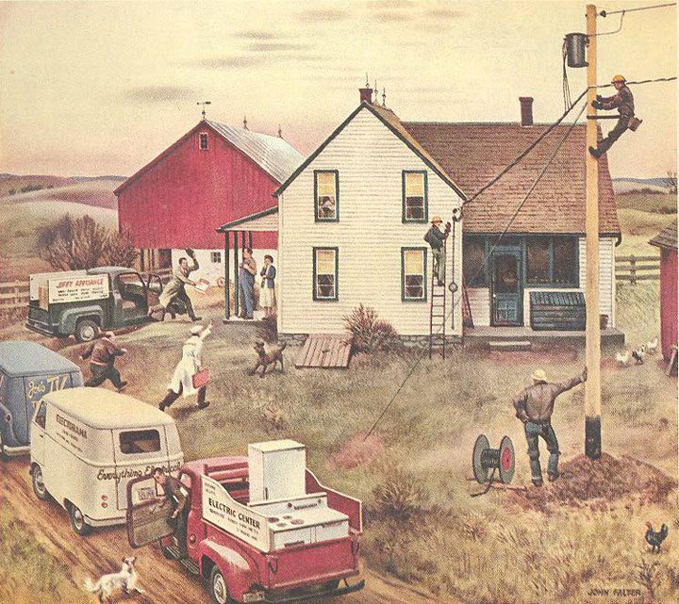
The Growth of Rural Electrification
Farms in the Northwest had low rates for electrification, but they were still generally higher than the national average of 10%. The numbers for the Northwest in 1934 were:
Washington: 27.5%
Oregon: 27.5%
Montana: 5.5%
Idaho: 29.8%
With the passing of the Rural Electrification Act, cooperatives could access low interest rate federal loans, which were further reduced from 3% to 2% in 1944.
While private companies generally did not compete in rural areas, rural cooperative became a direct competitor in regions where they decided to.
In the Northwest, with higher than average levels of rural electrification, this was an issue.
Despite the low interest rate loans, one of the greatest challenges to rural electrification was the high capital cost of central generation plants. The Columbia river offered a potential answer to this problem.
Notes:
Picture Details:
Drawing of Rural Electrification
Source: National Rural Electric Cooperative Association

Slide 55
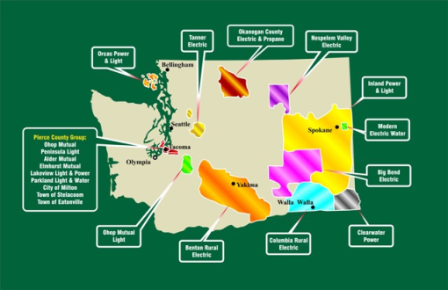
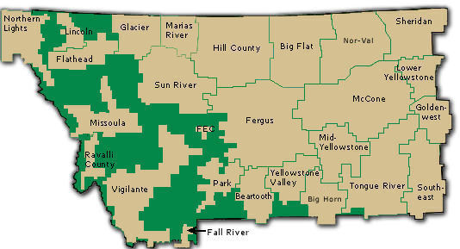
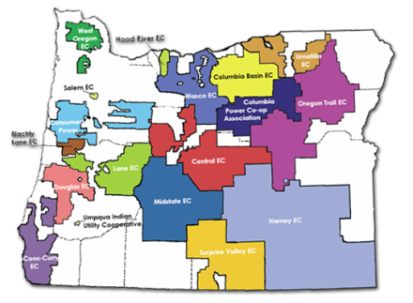
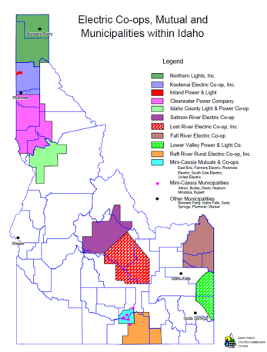
Rural Cooperatives in the Northwest
Today, rural cooperatives operate in all four of the Northwest states.
While each cooperative is an independent entity, they are able to draw on the benefits and resources made available since 1937.
Washington:
Members include: Benton Rural Electric Association, Inland Power and Light Co., Peninsula Light Co., Orcas Power and Light Cooperative, ect.
Oregon:
Members include: Columbia Basin Electric Cooperative, Douglas Electric Cooperative, Umatilla Electric Cooperative, ect.
Idaho:
Members include: Salmon River Electric Cooperative, Wells Rural Electric, Raft River Rural Cooperative, ect.
Montana
Members include: Big Flat Electric Cooperative, Missoula Electric Cooperative, Lower Yellowstone REA, ect.
Notes:
Picture Details:
Rural Cooperatives in Washington State, Oregon State, Montana, and Idaho.
Source: Washington Rural electric Cooperative Association, Oregon Rural Electric Cooperative Association, Montana Electric Cooperative Association, Idaho Public Utilities Commission.

Slide 56
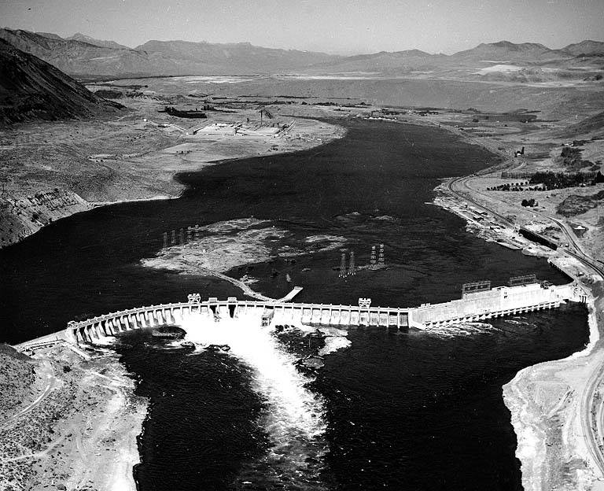
Development of the Columbia River System
Early dams for the production of electricity were across relatively small rivers.
In 1933 Puget Sound Power & Light Company, a holding of Stone and Weber Engineering Corporation, completed Rock Island Dam. It was the first dam to span the mainstem Columbia River; its sole purpose was to generate electricity
In 1934 construction began on the first two federal dams
Bonneville (first power house 1938:526.7 MW second power house 1983 (558.2 MW)
Grand Coulee dam (first and second power house 1941: 2,280 MW third power house 1974: 3,900 MW later upgraded+ 315 MW) Also 600MW of pumped hydro capacity. Bureau of Reclamation
As part of the National Resource Planning Board, established in 1933 to investigate comprehensive river basin planning, the Pacific Northwest Regional Planning Commission was composed of one representative each from Washington, Oregon, Idaho and Montana.
The commission’s report, dated Dec. 28, 1935, suggested an independent federal agency be created to market the power from Bonneville and Grand Coulee dams. The agency would be modeled after the Panama Canal Company. It would both operate the generators and build and operate the regional transmission lines. The commission recommended that power be sold for its cost of generation, not at a market rate, and that preference be given to public utilities for the federal power.
The Bonneville Project Act was passed by congress in 1937.
Notes:
Picture Details:
Rock Island dam, no date.
Source: University of Washington Digital Libraries

Slide 57
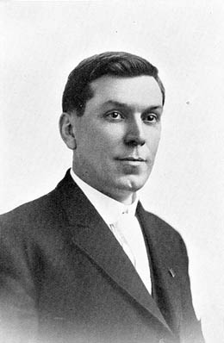
The Bonneville Project Act of 1937
The Bonneville Project Act of 1937 formed the Bonneville Power Administration (BPA) and tasked it with marketing power from the Bonneville and Grand Coulee Dams, as well as the construction of transmission facilities.
Unlike the TVA, the BPA does not produce electricity, it markets power from suppliers.
BPA markets power from 31 federal hydroelectric dams operated by the U.S. Army Corps. of Engineers, and the Bureau of Reclamation.
The first administrator was J. D. Ross, the former superintendent of Seattle City Light; a vocal opponent of private power companies.
The fact that public power is a preferred customer for federal power was an enabling factor for the success of rural cooperatives in the Northwest.
Notes:
Picture Details:
Photo of J.D. Ross. Former superintendent of Seattle City Light and the first administrator of the Bonneville Power Administration.
Source: University of Washington Digital Libraries

Slide 58
Public Utilities Districts
While the trend towards municipal power addressed the needs of people in cities, rural customers had few options.
While rural cooperative were an option if there was not an existing private system, if there was a system, then the competition would make it nearly impossible.
Public Utility Districts (PUDs) are public power entities that provide utility services similar to municipalities but without the taxing authority of a city.
Washington and Oregon have electrical PUDs.
Idaho and Montana do not electrical have PUDs.
PUDs were made possible by federal power with its preference for public power. They are generally non-profit organizations that answer to a commission, and they can cover one or more counties including cities.
Local control is something that makes PUD attractive alternatives to private power in some areas.
PUD came into existence in Washington in Oregon specifically because the private utilities had made in roads into rural areas, but the service was either of poor quality or too expensive. Had the private utilities not spread into these areas, PUDs would not have been necessary since an REA could have been formed.

Slide 59
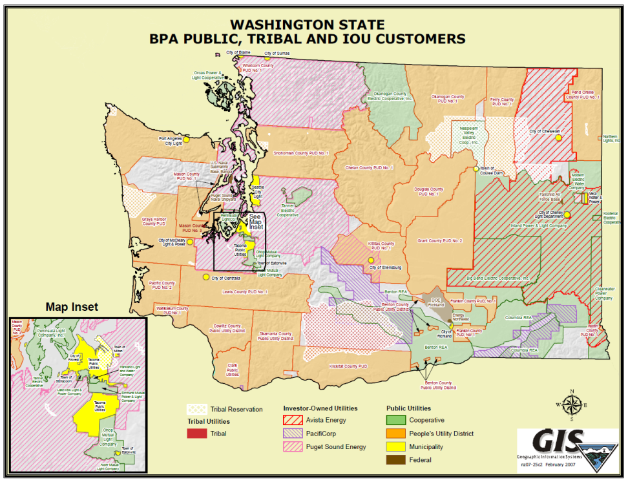
Washington State PUDs
In 1929 Public Initiative No. 1 was sent to the state legislature for formation of PUDs, in 1930 it passed with 54%.
Public Initiative No. 1 went into effect in 1931 and is now RCW 54, “conserve the water and power resources of the State of Washington for the benefit of the people thereof, and to supply public utility service, including water and electricity for all uses.”
PUDs had the ability to condemn and purchase the assets of private systems. This was done multiple times in Washington state and had a significant impact on private power.
The first PUD to go into operation was PUD No. 1 of Mason County. Formed in 1934, the PUD began serving Hoodsport and the surrounding area in 1935
In 1934, voters in Benton and Franklin counties approved the first countywide PUDs. But because of delays in obtaining generation resources it was Skamania County PUD in 1940 that became the first countywide PUD to begin operations.
Many PUDs get all or most of their power from the Bonneville Power Administration, and collectively they are BPAs largest load. (approx.. 25%)
Notes:
Picture Details:
Map of Washington State Utilities, ca 2012.
Source: Bonneville Power Administration

Slide 60
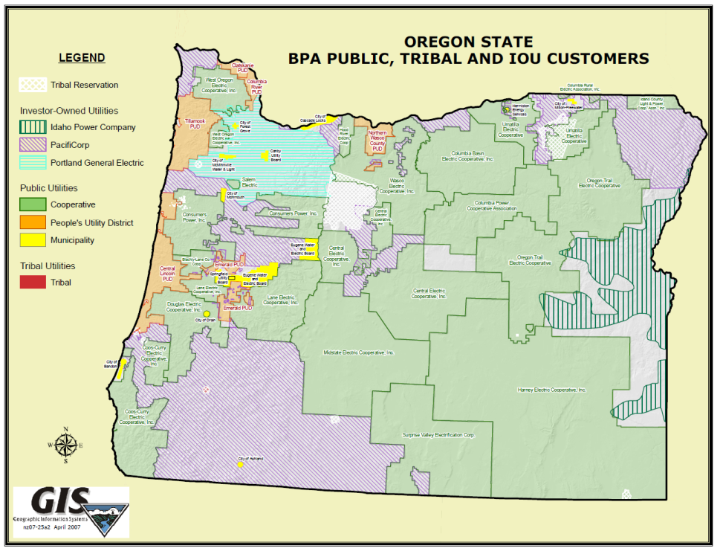
Oregon State PUDs
In 1930 Oregon voters passed a measure allowing for the formation of publicly owned and operated utilities.
1931 the Oregon legislature implemented it with the adoption of ORS 261.
Similar to PUDs in Washington, it was the low cost power from federal dams, and Bonneville's preference to market to public power, that made Oregon PUDs an attractive option.
In the 1940’s four people’s utility districts were formed:
Tillamook PUD
Central Lincoln PUD
Clatskanie PUD
Northern Wasco County PUD
Two more formed in the 1980’s.
Columbia River PUD
Emerald PUD
Notes:
Picture Details:
Map of Oregon State Utilities, ca 2012.
Source: Bonneville Power Administration

Slide 61

Problems Between PUDs and Private Power
PUDs have the legal authority to condemn privately owned assets and assume operations.
By 1941 condemnation lawsuits had been filed in 10 of the 19 counties served by Puget Sound Power & Light Company.
Clallam County PUD was the first PUD to condemn private assets on July 15th, 1945.
Clallam County paid $600,000 for the assets and Puget Sound Power & Light Company lost 1% of its revenue base.
While a 1% loss of revenue was not crippling, it heralded a number of changes that complicated the operations of private utilities in the Northwest.
Notes:
Picture Details:
Page 22 of “Power for Service”, a Puget Sound Power & Light Company Publication, ca 1944.
Source: University of Washington Digital Libraries

Slide 62

Federal Power and WWII
Through out the 1930’s, federal hydroelectric projects developed a massive generation surplus, far in excess of what was needed during the depression.
Bonneville power house 1 was over 500 MW
Grand Coulee left and right power house were over 2,200 MW (from 1941-1950)
The increased load due to war time production justified, after the fact, the construction of massive projects such as Grand Coulee Dam.
Energy intensive industries such as aircraft manufacturing and ship building were located in the Northwest because of the abundance of low cost electricity.
These industries contributed to the war effort, and laid the foundation for many key industries that currently exist in the Northwest.
Aluminum production
Aircraft manufacturing
Notes:
Picture Details:
Propaganda poster from the Second Work War.
Source: Bonneville Power Administration.

Slide 63
Federal Power at the end of 1949
By the end of 1949 the Northwest contained many of the key entities that exist today.
Private utilities
Municipal utilities
Federal power providers
Rural cooperatives
Public utility districts
There was still significant tension between privately run companies and public/federal power entities. This was especially true with new PUDs.
A high voltage transmission system was spreading across the region, interconnecting multiple generation sources with numerous loads.
After war production ramped down at the end of WWII, the region once again had a significant excess of electricity capacity. The low cost of electricity contributed to the robust post war time economy.

Slide 64


Part 4: Post War Growth Years (1950-1970)
Notes:
Picture Details:
Left: 230 kV Transmission line at Fairmont substation, Washington state. ca 2011.
Source:
Right: Shaft on one of Grand Coulees generators, ca 1951.
Source: University of Washington Digital Libraries

Slide 65
Part 4 Overview
Relationship between public and private power takes a turn for the worse in the Northwest.
The regions electrical infrastructure grows at an unprecedented rate.
Concerns with the stability of the new interconnected power systems.
The limits of the hydro system and where to go from there.
The beginning of environmental concerns.

Slide 66

Northwest Electricity Industry in 1950
At the conclusion of the Second World War, the economy in the Northwest was strong. There was an abundance of low cost generation, in part due to the federal hydro power projects of the New Deal.
The region was interconnected with a growing high voltage network that was seen as the key to reliability and efficiency.
The construction of Federal Power projects was beginning to slow.
Non-federal public power was beginning to grow, causing friction with private utilities.
Notes:
Picture Details:
2nd Ave. and Cherry St. looking north, Seattle Washington. ca 1959.
Source: University of Washington Digital Libraries

Slide 67

Further Tensions Between Private and Public Power
With the formation of PUDs in the 1930’s and 1940’, and the associated threat of condemnation, private power companies found it difficult to obtain financing for expansion or for new projects.
In 1949, the recently formed Snohomish County PUD moved forward with a condemnation that took 15% of Puget Sound Power & Light Company’s revenue base.
While there had continually been threats of condemnation for decades, in 1951 Seattle voters approved a buy out of all private power in Seattle, Puget Sound Power & Light Company instantly lost an additional 40% of it revenue base.
In 1952 a group of 6 PUDs offered to buy all of Puget Sound Power & Light Company’s assets, with the exception of Whatcom country. These companies included; Chelan, Kitsap, Jefferson, Skagit, Snohomish and Thurston.
The plan was initially approved, but for several reasons it did not occur:
While customers may not have liked a private power company, they liked the idea of being serviced by a company out of Spokane even less.
The sheer amount of litigation would have taken years to complete.
Notes:
Picture Details:
Cover of the Puget Power Annual Report for 1950.
Source: Puget Power Annual Report for 1950.

Slide 68

A Understanding Between Public and Private Power
When Seattle finally took control of assets within the city, a major source of uncertainty was gone for Puget Sound Power & Light Company .
Further uncertainty was removed when the proposed purchase of Puget Sound Power & Light Company by the 6 PUDs did not occur.
From 1930 to 1950 Puget Sound Power & Light Company had experienced problems financing new projects, but continued to pay off debt. As a result, the company had a very strong asset to debt ratio.
The combination of reduced uncertainty, and a strong ledger put Puget Power in a good position for future operation, and encouraged investors. This freed investment money for expansion, such as Upper Baker Dam.
Puget Sound Power & Light Company decided that it would focus on the growing suburban load as well as larger commercial and industrial customers, such as Sea-Tac airport and local refineries.
Notes:
Picture Details:
Upper Baker Dam
Source: Wikipedia.

Slide 69

The Interconnected Power System
Initially transmission lines were constructed by individual companies to connect remote dams with population centers, Snoqualmie and Willamette Falls being the earliest examples.
On July 9th, 1938 BPA energized its first line between the Bonneville dam and the city of Cascade Locks. Later that year on December 1st, BPA energized its first 230 kV line between Bonneville Dam and Portland.
By 1957, BPA had a significant 230 kV transmission system interconnecting the major dams on the Columbia. On August 26th legislation was signed that allowed BPA to wheel power across its system for a fee.
Wheeling made it possible for a large number of organizations to access the high capital cost transmission system. The demand for the service lead to expansion of the 230 kV system, and to its first 345 kV line from McNary Dam to Portland and Vancouver.
October 20th, 1953 BPA signed it first 20 year contract with Investor Owned Utilities.
September 20th, 1968 BPA energized the first of three AC lines of the Pacific Northwest-Southwest Pacific Intertie, now the California Oregon Intertie (COI). This enables sharing of resources with California.
May 21st, 1970 BPA energizes the HVDC line, 800 kV and stretched 845 miles.
October 9th 1970, BPA held a region wide meeting on environmental impacts. The National Environmental Policy Act had been passed the year before.
Notes:
Picture Details:
Fairmont substation, Washington State, ca 2012.

Slide 70

The 1965 Northeast Blackout
Prior to 1965 it was widely believed that the “modern” interconnected power systems were modern marvels that were too robust to fail.
That misconception was corrected on the evening of November 9th, 1965.
One of five parallel 230 kV lines supplying power from New York into Ontario tripped due to a incorrectly set over current relay. The power from this line was forced onto the 4 parallel lines, over loading all 4 remaining lines.
This interrupted 1,800 MW of power flowing into Canada and caused instabilities on the northeastern portion of the Eastern Interconnect.
The Eastern Interconnect separated into 4 islands, and 30 million people lost power.
In addition to sparking the deployment of modern Energy management Systems, the1965 blackout raised the question of whether something similar could happen in the Northwest.
This was especially relevant because of the planned transmission lines between the Northwest and California, designed to move large amounts of power in a multi-region resource sharing arrangement.
Notes:
Picture Details:
Cover of Life magazine, November 1965 Edition.

Slide 71

A Rapidly Growing Power System
Part of the reason for concern over the interconnected power systems was that they were larger and more complicated than any previous systems.
At this time there were 144 nonfederal generating utilities in the Northwest, and the region had just been connected with Canada (1961) and was about to be connected with the Southwest (1968).
Few people could fully appreciate the complexity of the system, and there were almost no analytic tools. In 1965 Moore’s Law was first published and the 12-bit PDP-8 minicomputer was first produced.
Despite concerns, the system continued to grow driven by the rapidly increasing load base.
Individual units were also increasing in size. At it completion in 1955 Chief Joseph Dam was rated at 2,620 MW on 27 units. (Each unit was 640 times the size of Edison's Jumbo Dynamo)
To accommodate these larger units, transmission voltages were increasing, first to 345 kV and finally to 500 kV. The higher 765 kV voltages were not implemented in the Northwest.
Notes:
Picture Details:
Chief Joseph Dam. ca 1956.
Source: University of Washington Digital Libraries

Slide 72

Electric Loads in the Growing Power System
The growth in the electric power system was attributed to two specific factors:
More people: The baby boomer generation
Higher per capita energy consumption
Residential Loads: an increase in the number, and variety, of appliance in the house.
Commercial Loads: Stores were becoming larger and more common.
Industrial Loads: At the end of WWII the United States was an industrial power house, and one of the few industrialized countries not left in ruins by the war.
Rural electrification: Farms were beginning to use more electricity, for living as well as working. Irrigation pumps were becoming a significant load.
Notes:
Picture Details:
Indian head test pattern. This was the test pattern that television stations would air after their evening signoff. Introduced by RCA in 1939 it was phased out in the late 1970’s as fewer stations actually signed off. It was also replaced by the SMPTE bars.
Source: Puget Power Annual Report for 1950.

Slide 73

The Last of the Federal Dams are Built
Despite the continuing increase in load, in 1952 “Partnership for Progress” was laid out in Dwight D. Eisenhower’s inaugural address. This effectively ended the planning of any new federal dams in the Northwest.
By 1975, the last 2 major federal dams were completed in the Columbia system:
Lower Granite on the Snake (1972)
Libby on the Kootenai (1975)
Statistics of the dams today:
274 dams in the Columbia River basin, 19 in British Columbia.
14 dams on the mainstem Columbia, 5 on the lower snake.
36,682 MW nameplate with an average output of 16,604 MW.
With the construction of federal dams coming to an end, the questions of who would build future generation was raised.
Notes:
Picture Details:
A map of the Pacific Northwest Reservoir System showing the locations of the dams.
Source: Bonneville Power Administration.

Slide 74

Washington Public Power Supply System (WPPSS)
The first major attempt to meet the future generation needs was the Washington Public Power Supply System.
The WPPSS was formed as a municipal corporation in 1957, by the Washington State Legislature, to produce power at cost for Northwest utilities. It was run by a board of directors who were from the 17 member utilities. Since the WPPSS was a state agency it could issue tax-exempt bonds.
The first project completed by the WPPSS was the small 27.5 MW Packwood Lake Hydroelectric Project. It was completed 7 months behind schedule, a foreshadowing of what was to come.
WPPSS also became the non-federal operator of the dual use N reactor at the Hanford Site. In a dual use reactor fuel for nuclear weapons is made and electricity for civilian use is produced. This was the only reactor of its design in the United States.
These small power projects would not address the problem of load growth, something more ambitious was needed.
Notes:
Picture Details:
Advertisement for WPPSS bonds, March 22 1962.
Source: University of Washington Digital Libraries

Slide 75

The Hydro-Thermal Power Plan
In 1957 the Army Corps of Engineers updated its 1929 308 report and determined that at current rate of load growth, all economically feasible hydroelectric resources would be subscribed by 1975. This revised 308 report detailed three distinct phases for power in the Northwest:
Phase 1: A system predominantly supplied by hydroelectric resources. This phase was estimated to end in 1975.
Phase 2: A system served by a combination of existing hydroelectric resources and soon to be built thermal plants. These thermal plants would be a combination of coal and nuclear.
Phase 3: A system served primary by thermal plants, with the continued operation of legacy hydroelectric resources.
In October 1968, BPA unveiled its vision of the future “The Hydro-Thermal Power Plan”. This plan required the construction of 21,400 megawatts of thermal power (2 coal-fired plants and 20 nuclear plants) , as well as 20,000 megawatts of new hydroelectric capacity between 1971 and 1990. The cost was estimated at just $15 billion.
The problem was that by federal law, BPA could not build its own power plants.
Notes:
Picture Details:
Cover page for submittal of the Army Corp. of Engineers 308 report.
Source: Google Books

Slide 76

The “Net Power” Arrangement
BPAs Hydro-Thermal Power Plan was a technical solution the load problem, but their were challenges in how to actually construct this many power plants.
Since BPA could not build its own power plants, the WPPSS would perform the actual construction, and would issue tax-exempt bonds to cover the cost of construction.
WPPSS would retain the title to the plants, but BPA would have the rights to their power output.
100% WPPSS 1&2
70% of WPPSS 3
BPA “negotiated” with Northwest utilities, and they agreed to sign long term contract for the power produced by the new plants.
This had the effect of spreading the cost to all of the utilities customers.
Notes:
Picture Details:
1,150 MW Columbia Generating Station, aka WPPSS 2.
Source: Energy Northwest

Slide 77

Moving Forward with the Hydro-Thermal Power Plan
In 1968, net power financing in place, BPA began moving forward with the first three projects, with utilities owning 33% of each project:
2 coal plants in Centralia (completed 72/73)
1 Nuclear power plant (Trojan, completed 76)
In 1969, it was decided that Phase I would be expanded to include a total of 5 nuclear power plants.
In 1970 H. R. Richmond, the BPA administrator, lobbied in Washington D.C. for net billing on the remaining plants. He stated that the seven phase 1 plants would only cost $1.7 billion, and would yield power rates as low at 1.5 cents/kwh.
While there were concerns about placing so much responsibility on Bonneville to back the plants, but concept was approved anyway and authorized Bonneville to use net billing for all of the remaining Phase I plants.
With the first power plants of Phase I moving forward, and a green light for the remaining plants, it looked as if the Northwest would be able to meet the expected load growth of the future. Additionally, because of the projects low cost of the plants, power rates should go down.
Notes:
Picture Details:
Cooling Tower for the Trojan Nuclear Power Plant, ca 2004.
Source:

Slide 78

The Emergence of Environmental Concerns
Throughout the 1960’s there was a growing environmental movement.
This movement was motivated by events such as free way riots and large power plant construction.
The National Environmental Policy Act (NEPA) was passed into law in 1969.
One of the most important aspects of NEPA was the requirement for all federal agencies to prepare Environmental Assessments (EAs) and Environmental Impact Statements (EISs).
When environmental concerns were factored in, the coal technologies of the early 1970’s were less attractive.
Many studies of the 1970’s showed that conservation was more cost effective than nuclear power, and posed no environmental impacts.
Notes:
Picture Details:
Power plant smoke stack.
Source: U.S Fish and Wildlife, National Digital Library

Slide 79
Post War Growth Years in 1969
By the end of 1969 the tensions between private and non-federal private power had settled out.
The Northwest was experiencing a strong growth in load in all sectors, with rural electrification effectively complete.
A strong interconnected transmission system existed between the generation sources and the loads, and the system was improving.
The limits of the Columbia river system were thought to be near, with the new Hydro-Thermal plan as a proposed solution.
There was a growing level of public concern over environmental issues, which was impacting the construction of new infrastructure.

Slide 80


Part 5: Challenges (1970-1985)
Notes:
Picture Details:
Left: Wanapum dam, Washington State, ca 2010
Right: WPPSS cooling tower for unit 5, Satsup WA, ca 2012

Slide 81
Part 5 Overview
WPPSS and BPA move forward with the hydro-thermal plan
The energy crisis of 1973
A nascent wind technology
The energy crisis of 1979
Reduced load growth and problems with WPPSS

Slide 82

Northwest Electricity Industry in 1970
Energy shortages were predicted and the Columbia River system was close to fully subscribed.
Load was projected to steadily increase despite the lack of sufficient generation.
WPPSS and BPA were moving forward with the hydro-thermal plan, financed by net power, to meet the growing load.
A strong interconnected power system made the new generation, spread across the region, technically feasible.
Notes:
Picture Details:
Wanapum dam, Washington State, ca 2010

Slide 83

Construction and Operation of the New Thermal Power Plants
1969 Construction began on the two 670 MW coal plants in Centralia. (Operational: 1972/73-present)
1970 construction began on the 1,130 MW Trojan Nuclear Power Plant in Oregon State. (Operational: 1976-92)
1973 construction began on the 1,150-megawatt WPPSS Project 2, at Hanford WA. (Operational: 1984-present)
1977 construction began on the 1,150-megawatt WPPSS Project 1, at Hanford WA. (Never operational)
1977 construction began on the 1,150-megawatt WPPSS Project 3, at Hanford WA. (Never operational)
Notes:
Picture Details:
Trojan Nuclear Power Plant, ca 1980.
Source: University of Washington Digital Libraries

Slide 84

Energy Crisis of 1973
In 1973 the Organization of Arab Petroleum Exporting Countries (OAPEC) proclaimed an oil embargo on the United States. This was in response to the United States support of Israel in the Yom Kippur War.
In addition to the direct impact the disruption in oil imports had on the economy, there were a number of impacts on the electricity industry:
A desire to find “domestic energy” sources.
A culture of conservation was reinforced.
The emergence of energy efficiency programs
With the removal of the oil embargo in 1974, people tended to go back to their normal routine, but the public had been introduced to the impacts of energy shortages.
Many oil fired plants were shut down, or converted to natural gas or coal.
Notes:
Picture Details:
Photo of a man reading a Seattle newspaper headline about gas rationing, ca 1973.
Source: University of Washington Digital Libraries

Slide 85

Wind as a Potential New Generation Source
In response to the oil crisis of 1973, the DOE and NASA teamed to examine the feasibility of utility scale wind turbines.
One of the driving reasons for this work was that utility scale wind was seen as a domestic energy source, and as such, tit would be secure from disruption.
In 1982, three 2.5 MW MOD-2 wind turbines were installed near Goodnoe Hills WA.
These three units showed that it was technically feasible to generate utility scale wind. But, like many demonstration projects, the three units on their own were not cost effective.
With the end of the oil crisis energy prices decreased and with it, interest in utility scale wind generation.
The three MOD-2 units were removed by PG&E in 1988 and replaced with the 47 unit, 94 MW Goodnoe Hills Wind Farm in 2008.
Notes:
Picture Details:
Three of the MOD-2 wind turbines at Goodnoe Hills in 1981.
Source: Wikipedia

Slide 86

Energy Crisis of 1979
The Iranian Revolution of 1979 once again severely disrupted international oil markets when the American backed Shah of Iran was replaced with the Ayatollah Khomeini.
Even after the revolution, oil prices remained high because of the outbreak, and continuation, of the Iran-Iraq war.
While not as severe as the 1973 crisis, a second crisis just 6 years after the first had an impact on the American psyche.
The idea of domestic energy security had been formally introduced with the Carter Doctrine.
The combination of the 1973 and 1979 energy crises changed the way the nation viewed energy.
Notes:
Picture Details:
Line at a gas station in Maryland, June 15th, 1979.
Source: Wikipedia

Slide 87
The Public Utility Regulatory Policies Act (PURPA)
By the latter half of the 20th century it was clear that power systems were a natural monopoly. Redundant infrastructure for the delivery of electric power was inefficient.
The generation of electric power is not a natural monopoly, but a company that operates the wires is going to give preference to their own generation.
As a result, existing operating companies could effectively keep out any new generators.
The Public Utility Regulatory Policies Act (PURPA) was passed in 1978 and required utilities to purchase power from any qualified producer. The specific implementation was left to the various states.
Enabled significant cogeneration from large commercial and industrial customers.
Enables interconnections for renewables, including at the distribution level.
PURPA has been partially superseded by some legislation, such as the added requirement for utilities to provide net metering under Section 1251 of the Energy Policy Act of 2005.

Slide 88
Lower than Expected Load Growth
Between 1946 and 1970 load in the Northwest grew at an average rate of 7%.
Estimates for future load growth were generally based on a linear continuation of this rate.
These estimates were overly optimistic and failed to take into account a number of factors:
Slowing economy
Price elasticity of electricity due to the increasing rates
Environmental concerns and energy conservation programs, were reducing the rate of increase.
As a result, the anticipated customer base, that would justify the cost of new generation, was not materializing.

Slide 89

WPPSS Turns to “WHOOPS”
In 1972 the IRS determined that the tax except status of net billing was illegal. Without the tax except status, the cost of issuing bonds increased significantly.
One of the major problems with the Phase 1 projects was that non of the participating members had any experience with capital project of this size. As a result, cost quickly began to skyrocket.
In January 1982, the WPPSS board stopped construction on Plants 4 and 5 when total cost for all the plants was projected to exceed $24 billion.
Since plants 4 and 5 generated no power, and generated no revenue, the system was forced to default on $2.25 billion in bonds. This meant that the member utilities, and ultimately the rate payers, were obligated to pay back the borrowed money. Numerous lawsuits began.
Plants 1 and 3 were never finished either, but their costs were backed by the Bonneville Power Administration and the power it generated from the Columbia River Dams, cost that were eventual passes on to the customers as well.

Slide 90

WHOOPS…
It was not until December 24, 1988, the parties in the various lawsuits reached a settlement of $753 million.
Some of the system's approximately 75,000 bondholders would receive 40 cents on every dollar invested; others got as little as 10 cents. Because a court found that some of the bond monies for plants 4 and 5 were spent on plants 1 and 3, participants in those projects were held liable for the default. Seattle's share was $50 million, of which $43.2 million came from insurance companies. The last settlement was reached in 1995.
Plant 2 at Hanford was completed in 1984 and is called the Columbia Generating Station. It produces 12 percent of the power supplied by the Bonneville Power.
The WPPSS was at the center of the largest municipal bond default in the history of the country.
Notes:
Picture Details:
WPPSS cooling tower for unit 3, Satsop WA, ca 2012

Slide 91
Challenges in 1984
Due to numerous social factors, the rate at which the Northwest consumed electricity began to slow.
The countries dependence on foreign energy sources, and their interruptions in 73 and 79, had started the first attempts at utility scale wind energy.
Multiple large nuclear power plants were abandoned mid-construction because of cost over-runs and lack of a need.
The WPPSS was at the center of the largest municipal bond default in the history of the country.

Slide 92


Part 6: The Modern Electric System in the Northwest (1985-Present)
Notes:
Picture Details:
Left: 1.8-megawatt Vestas V80 turbine at Wild Horse Wind Farm, East of Ellensburg Washington.
Right: 500 kV Transmission Line near Satsop substation, Satsop Washington.

Slide 93
Part 5 Overview
Regulatory policies that affect present day operations; Northwest Power act, EPACT 2005, EISA 2007, and ARRA 2009.
A second attempt for wind in the Northwest.
California's attempt at deregulation and how it impacted the Northwest.
The future role of Federal Power?
The smart grid in the Northwest.
Workforce challenges.

Slide 94

Northwest Electricity Industry in 1985
By the mid 80’s the country was coming out of a recession and load growth was beginning to pick up.
The Northwest had a strong transmission system with relatively new distribution systems, but the technologies they were based on were old, and the systems were aging. Additionally, the construction of new infrastructure was becoming more difficult, and less common
Washington And Oregon::
Federal
Municipal
Private
PUDs
Idaho and Montana:
Federal
Municipal
Private
Notes:
Picture Details:
1.8-megawatt Vestas V80 turbines at Wild Horse Wind Farm, East of Ellensburg Washington.

Slide 95

PACIFIC NORTHWEST ELECTRIC POWER PLANNING AND CONSERVATION ACT
As was seen with the WPPSS bond default, the Northwest needed some guidance on how to operate its electrical infrastructure.
On December 5, 1980, Congress passed the Pacific Northwest Electric Power Planning and Conservation Act, which authorized the four states of Idaho, Montana, Oregon, and Washington to form the Northwest Power and Conservation Council. This was signed into law by President Carter as one of his last Presidential acts.
The Northwest Power Act directs the Council to “prepare a plan to protect, mitigate and enhance fish and wildlife of the Columbia River Basin that have been affected by the construction and operation of hydroelectric dams while also assuring the Pacific Northwest an adequate, efficient, economical and reliable electric power supply.” The Act was passes in response to three key issues:
First: It was clear that there would be no new federal dams, so the question of who received what amount of the existing resources arose.
Second: The issues of load forecasting and how to best meet the regions generations needs we clearly not understood.
Third: declining salmon runs on the Snake Rive, which were at least partially due to the dams.
The act was attempting to address a number of issues, both technical:
Disputes over power allocation
Inability to accurately forecast regional loads
Distrust of utilities, and BPA in particular,
A new interest in conservation
Environmental impacts, as highlighted by the declining salmon runs.
The Northwest Power Act is a unique piece of legislation, one that responded to crises in a unique part of the country, balancing the public interest in mitigating the impacts of hydropower on fish and wildlife against the public interest in an affordable, reliable electricity supply.

Slide 96
The Energy Policy Act of 2005
The Energy Policy Act of 2005 was passed as an attempt to address national problems that had arisen due to deregulation, reduce infrastructure investment, and growing load.
The Energy Policy Act of 2005 contains numerous provisions, some of the more prominent are:
North American Electric Reliability Council is replaced by North American Electric Reliability Corporation.
National Interest Electric Transmission Corridors: Where the limitations of the exiting transmission system adversely affect American citizens, the DOE, through FERC, can permit a project director to exercise eminent domain to purchase necessary property.
All public electric utilities are required to provide net metering to customers who request it.
Sets federal reliability standards for the electricity grid. FERC has the authority to implement these standards and uses the newly formed NERC to execute; these rules apply to distribution as well as transmission operators. (Reliability Standard for the Bulk Electric System of North America)
The fluids used for Hydraulic fracturing “fracking” were exempt from the Clean Air Act, the Clean Water Act, the Safe Drinking Water Act, and the Comprehensive Environmental Response, Compensation, and Liability Act of 1980.

Slide 97
The Energy Independence and Security Act of 2007
The Energy Independence and Security Act of 2007 was passed “to move the United States toward greater energy independence and security, to increase the production of clean renewable fuels, to protect consumers, to increase the efficiency of products, buildings, and vehicles, to promote research on and deploy greenhouse gas capture and storage options, and to improve the energy performance of the Federal Government, and for other purposes.”
The Energy Independence and Security Act 2007 contains numerous provisions, some of the more prominent are:
Provided incentives for electric vehicles and loan programs for battery technologies.
Provided incentives for non-federal fleet vehicles to move to hybrid vehicles, and established conservation requirements for federal fleet vehicles.
Requires increased efficiencies for light bulbs, effectively banning incandescent, (40W-150W), light bulbs.
Establish new efficiency standards for appliances, motors, and HVAC equipment.
Numerous provisions for increased building standards.

Slide 98

The American Recovery and Reinvestment Act of 2009
The American Recovery and Reinvestment Act of 2009, or the stimulus, was a controversial act passed to respond to the recession of the late 2000’s. The primary motivation was from Keynesian theory that advocates for the government spending in time of weak economic activity.
The American Recovery and Reinvestment Act of 2009 contains numerous provisions, some of the more prominent are:
Tax incentives for individuals and companies.
Tax incentives for education and healthcare.
Infrastructure investment, including energy infrastructure. Energy infrastructure accounted or $21.5 billion of the total $831 billion, including:
$3.25 billion for the Western Area Power Administration of transmission upgrades.
$3.25 billion for the Bonneville Power Administration of transmission upgrades.
$4.5 billion for 8 Grant and 100 Demonstration Projects.

Slide 99
A Second Attempt at a Wind Industry
In the late 70’s, and early 80’s, a weak economy coupled with a fading memory of the .73 and 70 energy crisis resulted in little or no interest in utility scale wind energy. It was not until the late 90’s that there was a renewed interest in this technology.
1998 Vansycle Wind Project began operation. This was the first commercial wind farm in Oregon. Operated by NextEra Energy resources. (38 660 kW turbines)
2001 Stateline wind farm began operation. Operated by Florida Power and Light (454 660 kW Vestas turbines); Stateline 1 (2001), Stateline 2 (2002), Stateline 3 (2009):
2003 Nine Canyon wind farm began operation. Operated by Energy Northwest (49 1.3 MW Bonus turbines)
2006 Wild Horse wind farm began operation. Operated for Puget Sound Energy (127 1.8 MW Vestas V80 turbines)
2009 Windy Point/Windy Flats wind farm began operation. Operated for the Tuolumne Wind Project Authority and the Southern California Public Power Authority (156 2.3 MW Siemens turbines and 20 2.0 MW RE power turbines)
2012 Shepherds Flat Wind Farm began operation. Operated for Southern California Edison (338 2.5 MW GE turbines)
Nameplate capacity in the Northwest (as of 2011)
Washington: approx. 2,500 MW
Oregon: approx. 2,500 MW
Idaho: approx. 600 MW
Montana: approx. 380 MW
Notes:
Picture Details:
1.8-megawatt Vestas V80 turbine at Wild Horse Wind Farm, East of Ellensburg Washington.

Slide 100

The Driving Factors for the New Wind Industry
The growth of the wind industry in the Northwest is directly tied to subsidies and mandated, state level, Renewable Portfolio Standards (RPS).
Washington: Utilities with >25,000 customers must have 15% of their power from renewable resources by 2020. Existing hydro is not counted as renewable.
3% by 2012
6% by 2016
15% by 2020
Oregon: The three largest utilities must have 25% by 2025. (PacifiCorp, Portland Gas and Electric, and Eugene Water and Electric Board)
5% by 2011
15% by 2015
25% by 2025
Idaho: None
Montana: Utilities with >5,000 customers must have 15% of their power from renewables by 2015.
5% by 2009
10% by 2014
15% by 2015
Notes:
Picture Details:
Renewable portfolio standards for the united states, May 2011.
Source: Federal Energy Regulatory Commission

Slide 101

Deregulating California’s Electricity, and what it Meant for the Northwest.
The California energy markets were never truly de-regulated, but actually re-regulated in 1996.
California utilities were instructed to sell off generation assets to private operators, with the expectation that FERC would regulate their operation, especially for out of state units.
In 2000 and 2001 California experienced extreme shortages of energy, despite an installed capacity that far exceeded demand. The shortages were due to market manipulations, by companies such as Enron, designed to raise rates. FERC did very little to intervene, primarily because FERC has very little actually ability to regulate a market so large.
Due to the re-regulation, residential rates were fix, while wholesale rates were market based. As a result, utilities had to pay 10-20+ times more for power than they could sell to their customers.
This caused a number of utilities to either go bankrupt, or to incur heavy financial losses.
Because of the COI, utilities in the Northwest were also heavily impacted by the market manipulation, both technically, as well as financially.

Slide 102
The Future Role of Federal Power?
Today in the Northwest the role of federal power can be divided into two categories:
Dams: Army Corp. of Engineers and the Bureau of Reclamation
Transmission: Bonneville Power Administration
While these federal roles exist, there are private companies that operate dams, and to a greater extent, portions of the regions interconnected transmission system.
Operation of the federal resources has been controversial at times because of the competing interests. Specifically, the federal dams are operated for flood control, irrigation, recreation, salmon concerns and the generation of electricity.
In the summer of 2011 there was a conflict between fish and wildlife issues, and the integration of wind. Because of the BPA environmental dispatch policy, wind farms were forced to curtail to prevent dissolved gases from affecting salmon.
BPA said the policy, implemented between May and July of last year, resulted in the curtailment of 97,557 megawatt-hours of wind generation, or 5.4 percent of the total wind output connected to BPA's grid, for a loss of $2.15 million in renewable energy credits (REC) and production tax credit (PTC) income.
Later, FERC ordered Bonneville to revise its environmental redispatch policy and that they must treat wind generators on equal footing with federally generated hydropower in the Pacific Northwest.
In the future, how will the federal power entities address conflicting issues, and what new conflicting issues may arise?

Slide 103

The Smart Grid in the Northwest
Historically, the challenges of the nation’s power system have been addressed by building more generators, more transmission lines, and expanding distribution systems. This is equally true of the Northwest.
While this has worked in the past, environmental concerns, increased infrastructure costs, and a general public desire to not have infrastructure in their back yards have made this approach more difficult.
The smart grid is a concept that involves leveraging modern technologies to solve traditional problems in non-traditional ways.
Most of the smart grid solution are based on leveraging communications system, advanced sensors, and increased computing capability to increase the effectiveness of the existing infrastructure.
There is no single definition for what is, and is not, a smart grid.
Notes:
Picture Details:
National Institute of Standards and Technology smart grid conceptual model.
Source: National Institute of Standards and Technology

Slide 104
Workforce Challenges
Throughout the 80’s and 90’s many of the power engineering programs in the U.S. were in decline, with many programs disappearing completely.
This created a large 20 year gap within the workforces of many utilities.
With many senior technical experts ready to retire, there are very few qualified people ready to take their place.
Additionally, new technologies are being introduced to the industry at an unheard of rate.
There is a significant need for early to mid career personnel who are able to understand how the new technologies will fit into the existing systems.

Slide 105
The Northwest Power System Today
Today the electrical infrastructure of the Northwest is part of the larger interconnected Western Electrical Coordinating Council (WECC); a system that synchronously interconnects nearly half of North America, and electrically interconnects the entire continent.
The majority of energy in the Northwest is still supplied by hydroelectric resources, but no new dams are planned.
Wind generation is a quickly growing component of the regions generation mix, which is posing challenges for the system operators.
New technologies are rapidly being deployed in nearly every utility, at all levels.
Currently there is a lack of trained personnel at all levels. Additionally, much of the workforce is eligible for retirement in the near future.

Slide 106
Concluding Comments
Similar to the rest of the country, the power system of the Northwest began as a collection of isolated systems powered by steam.
But quickly the hydrological resources of the region were harnessed, and today provides the majority of the electrical needs.
Private, municipal, and federal organizations have all played a role in the development of the system. As a result, there are numerous stakeholders involved in the industry.
To get to where it is today, the system had to overcome significant challenges; technical, social, as well as regulatory.
While the industry has traditionally been slow to adopt new technologies, or to embrace change, the emerging generation of smart grid technologies is quickly changing the old ways of thinking.

Slide 107
Conclusion

